Slide 1
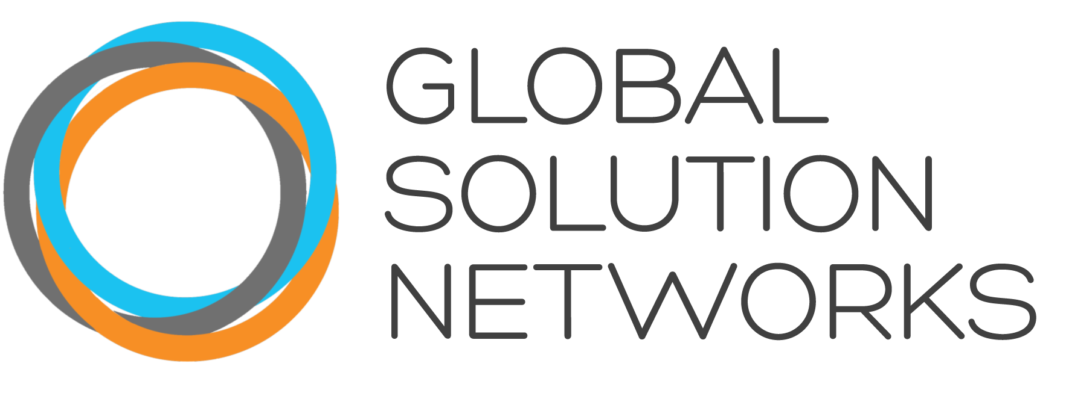
GSN Summit Toronto: Solving the World’s Problems Differently
January 30, 2014
1 | © 2014 Global Solutions Networks. All Rights Reserved.

Slide 2
Welcome and Introductions
Joan Bigham, Managing Director, GSN
Jamison Steeve, Executive Director, MPI
2 | © 2014 Global Solutions Networks. All Rights Reserved.

Slide 3
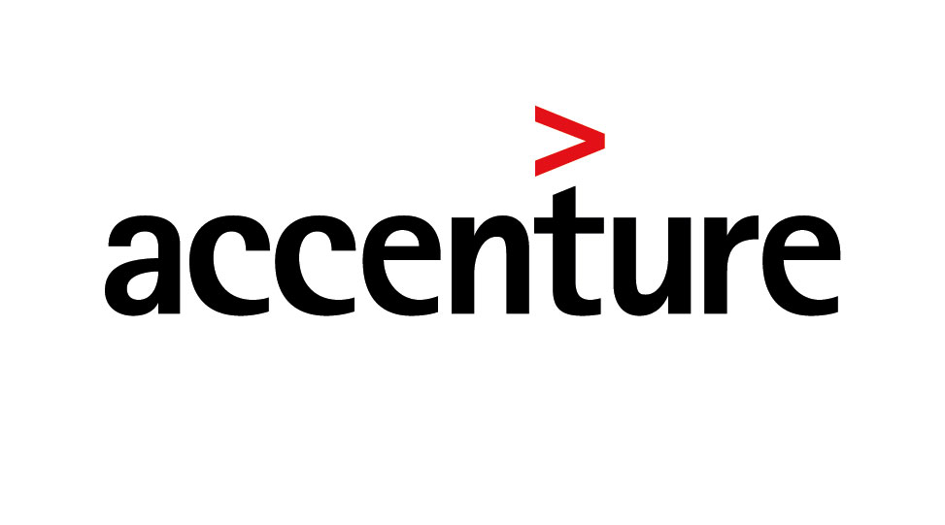
GSN Program Sponsors
3 | © 2014 Global Solutions Networks. All Rights Reserved.

Slide 4
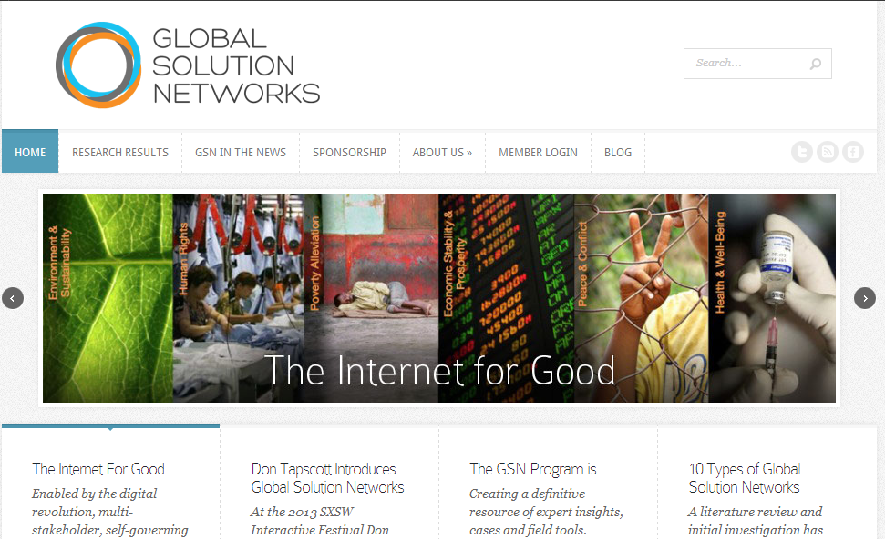
4 | © 2014 Global Solutions Networks. All Rights Reserved.
www.gsnetworks.org

Slide 5
Agenda Highlights
GSN Research Update: What We’ve Learned So Far – Joan Bigham, Managing Director
Global Solution Networks: Tackling the Hard Issues – Don Tapscott, Executive Director
Key Stakeholders in Global Problem Solving – Panel Discussion Bruce Jenks, Michael Denham, Dan Wellers, Giles Gherson, Thomas Debass
Mobile Computing & Global Problem Solving – Anthony Williams, Executive Editor
Global Solution Networks for Solving Real Problems– Panel Discussion Kathryn Semogas, Kristy Buckley, Faizal Karmali, Sohier Hall
Global Solution Network Design Challenge – Roundtable Discussions
Water Scarcity
Urban Congestion
Gender-based Violence
Youth Unemployment
Conflict & Fragile States
Nutrition & Global Health
5 | © 2014 Global Solutions Networks. All Rights Reserved.
Notes:
Insert 7 issues

Slide 6
What have we learned so far?
Joan Bigham
6 | © 2014 Global Solutions Networks. All Rights Reserved.

Slide 7
Where We Started…
Global Solution Networks address every conceivable issue facing humanity.
Yet to date there has been no systematic study of this phenomenon or any attempt to understand the potential of GSNs for improving the state of the world.
Members of the GSN Program have a voice in understanding, shaping and applying the new models that are increasingly important in solving global problems.
7 | © 2014 Global Solutions Networks. All Rights Reserved.

Slide 8
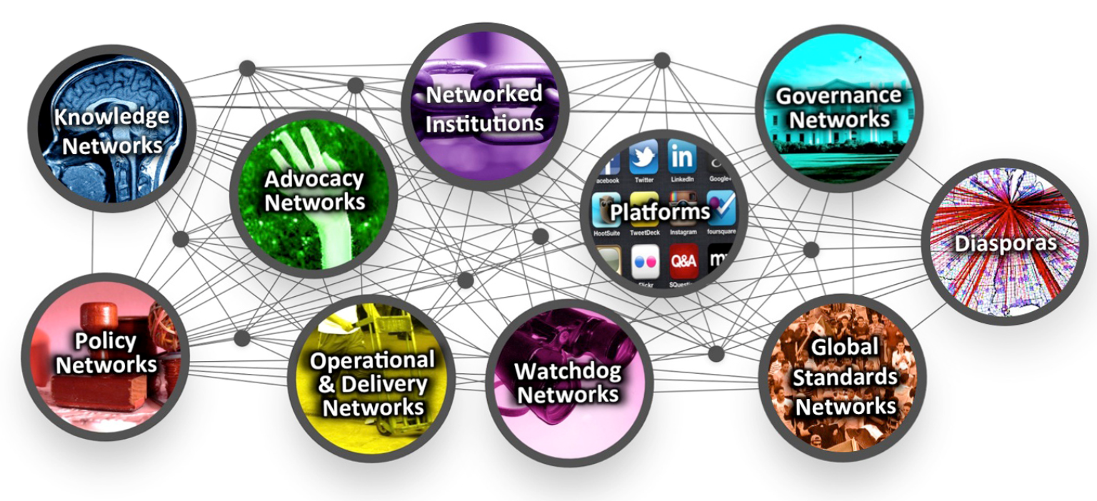
Early Results
Taxonomy of Global Solution Networks
Global Solution Networks have 4 characteristics:
They involve civil society, business and government
They attack a global problem
They make the most of the Internet and digital tools
They are not controlled by states or corporations
8 | © 2014 Global Solutions Networks. All Rights Reserved.
Notes:
Foundation research gave us our taxonomy and the structure for our research framework

Slide 9
What We’ve Learned – Network Types
GSNs can also be excellent examples of more than one network type simultaneously, and can also demonstrate dynamic evolution from one network type to another.
Example: 350.org
Advocacy and Platform Network
None of the taxonomic types solves a WHOLE problem – they only solve the piece they tackle, and they solve it to the degree that their GSN can contribute.
But…
9 | © 2014 Global Solutions Networks. All Rights Reserved.
Notes:
We developed the taxonomy – which gives us a framework and a vocabulary on which to base our next look.
our taxonomy provides useful categories for comparison and discussion but it’s important to note that, while the categories are comprehensive, they are not mutually exclusive.
An organization that fits into the defining parameters of one network category may also have characteristics that make it a candidate for classification in other categories in the taxonomy. In addition, networks are dynamic and may change, evolve or adapt to their operating area in ways that may alter the way in which they are catalogued in our discussions. some of the cases presented in the pages that follow highlight just such multi- type networks. they have been selected here for discussion of Advocacy networks, although several have also appeared in other papers in our collection as being representative of other network characteristics. It is just such overlap and such unique combinations of characteristics that make the study and observation of these networks so compelling and so vital.

Slide 10
Our Approach
Research Agenda
STREAM 1: What Makes GSNs Tick?
STREAM 2: The Five Pillars of Global Solution Networks
STREAM 3: Investigation of the 10 Types of Global Solution Networks
STREAM 4: Network Solutions for Global Issues
STREAM 5: GSN Case Studies
STREAM 6: GSN Interviews
10 | © 2014 Global Solutions Networks. All Rights Reserved.

Slide 11
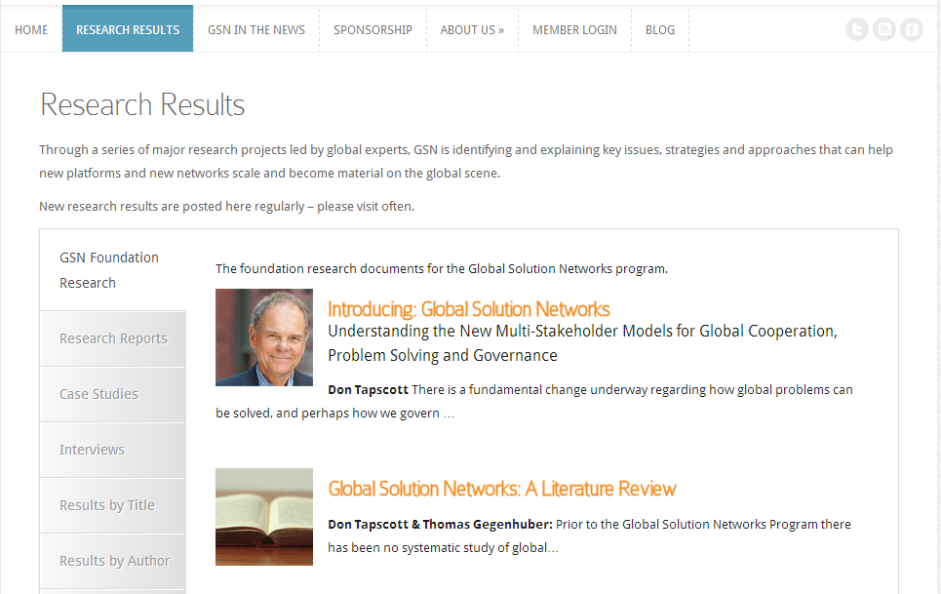
www.gsnetworks.org
11 | © 2014 Global Solutions Networks. All Rights Reserved.

Slide 12
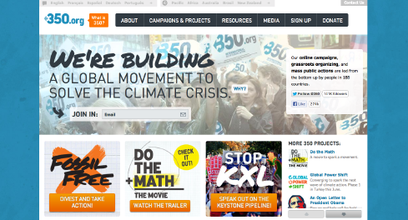
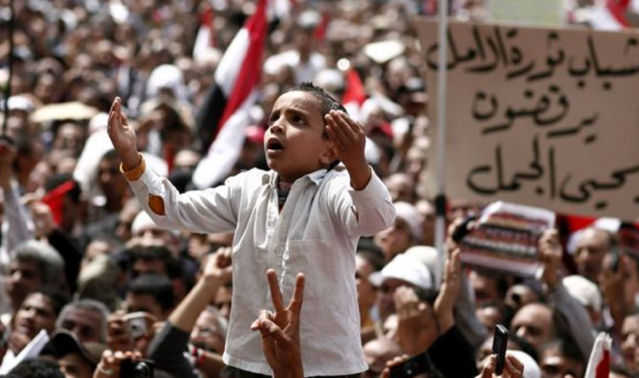
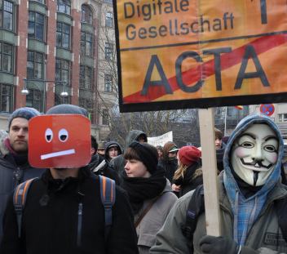
Stream 3 - Network Type: Platforms
350.org – a global movement to address climate change
The Arab Spring was the world’s first leaderless revolution.
The power of Avaaz-inspired anti-ACTA protests caught European policymakers by surprise.
12 | © 2014 Global Solutions Networks. All Rights Reserved.
Notes:
Platforms for advocacy provide capabilities for social activists to share information and organize for social change, whether raising money for their causes or garnering supporters for an online petition. Examples include Causes.com, Avaaz.org and Change.org.
AVAAZ is a community of 50 million change-minded activists that campaigns in 15 different languages and involves people of all backgrounds and walks of life. Like Change.org, the Avaaz community makes its voice heard on a wide range of local and global issues by signing petitions, funding media campaigns and direct actions, emailing, calling, lobbying governments and organizing “offline” protests and events.
ACTA - In one of its most notable accomplishments, Avaaz delivered a petition signed by nearly 3 million members to the European Parliament calling on decision-makers to reject the Anti-Counterfeiting Trade Agreement treaty (ACTA). Ostensibly designed to establish international standards for intellectual property rights enforcement, Internet freedom campaigners saw ACTA as a dangerous attack on fundamental rights, including freedom of expression and privacy. Facing mass opposition across Europe, the European Parliament’s own press release announcing ACTA’s eventual defeat in January 2012 identified the Avaaz petition as a key factor in its decision.

Slide 13
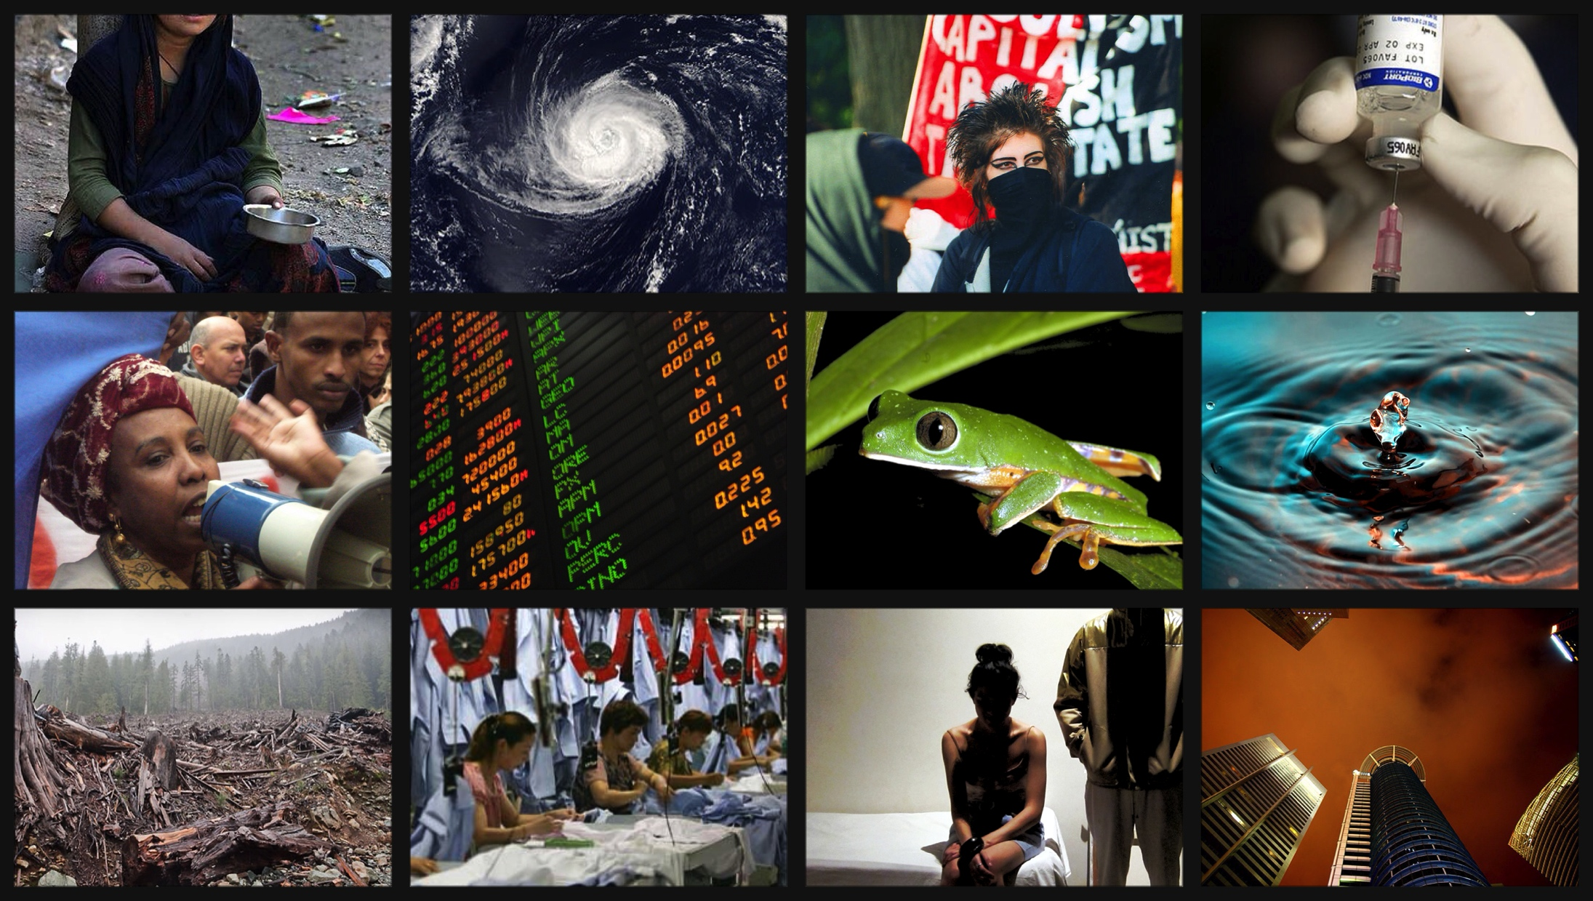
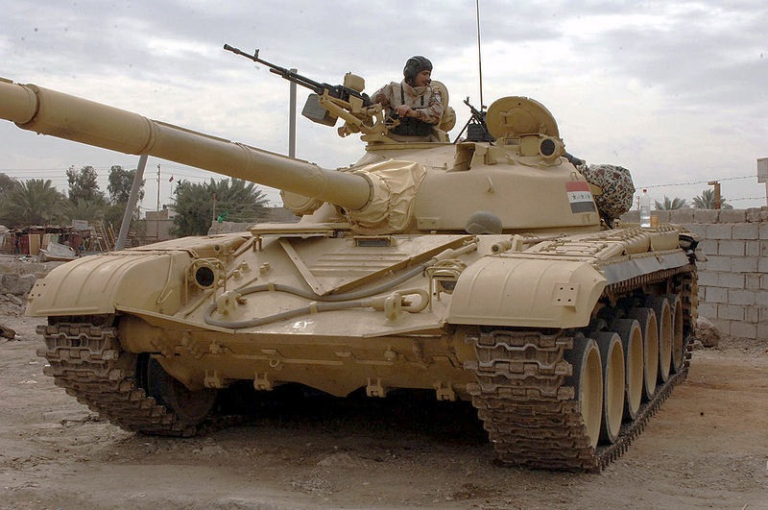
Climate Change
Infectious
Disease
Poverty
Conflict
Stream 4 – Global Issues
Racism
Water
Global Problems
Economic Collapse
Species
Extinction
Sexual
Violence
Human Rights Violations
Corporate Greed
Environmental
Destruction
13 | © 2014 Global Solutions Networks. All Rights Reserved.

Slide 14
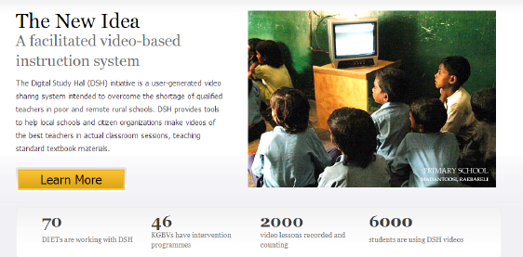
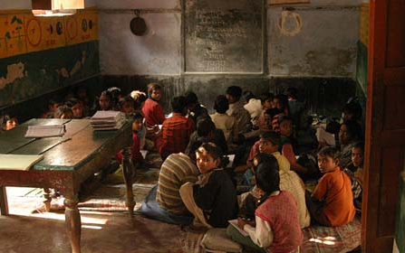
Stream 5 - Case Study: Digital Study Hall
Digital Study Hall impact to date
The children Digital Study Hall helps
14 | © 2014 Global Solutions Networks. All Rights Reserved.

Slide 15
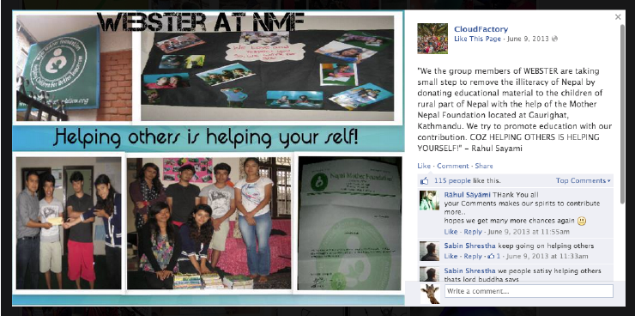
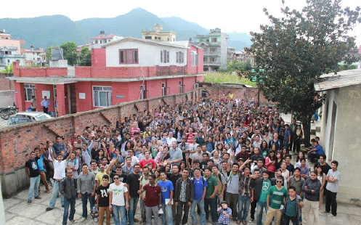
Stream 5 - Case Study: CloudFactory
Workers build teams, community and economic stability
CloudFactory workers – skill development contributes to community leadership
15 | © 2014 Global Solutions Networks. All Rights Reserved.

Slide 16
What We’ve Learned – Key issues
Network Management
“Work smarter not harder” with a diversity of engagement options Mobile Computing
Keep one eye on the future – Eventually, our mobile devices will disappear Mobile Computing
Prepare to cede some control to broaden engagement Crowdsourcing
Prepare for exponential change Global Problem Solving
Legitimacy
Legitimacy is a continuum … there may well be varying degrees of legitimacy for various purposes and constituencies Legitimacy
Is a GSN a good instrument for the pursuit it undertakes? GSN team
Inclusive processes are key Policy Networks
Scaling
Aggregations and replications across countries are expensive but essential New Tools for Tackling Poverty
A GSN can grow by narrowing its focus rather than overwhelming people with too many tools and functions Advocacy Networks
Implementation
A growing number of tools exists to boost innovation and further problem-solving agendas Seven Power Tools
Importance of momentum – tapping the energy that drives digital progress and engagement GSN team
16 | © 2014 Global Solutions Networks. All Rights Reserved.

Slide 17
Tackling the Hard Issues Don Tapscott www.gsnetworks.org 416 863 8801 @dtapscott #GSNToronto
17 | © 2014 Global Solutions Networks. All Rights Reserved.

Slide 18
Global Solution Networks:
What is a multi-stakeholder network
for global problem solving, cooperation and governance?
18 | © 2014 Global Solutions Networks. All Rights Reserved.
Notes:
18

Slide 19
Climate Change
Infectious
Disease
Poverty
Conflict
Racism
Water
Global Problems
Economic Collapse
Species
Extinction
Sexual
Violence
Human Rights Violations
Corporate Greed
Environmental
Destruction
19 | © 2014 Global Solutions Networks. All Rights Reserved.

Slide 20
Global Solution Networks
Diverse Stakeholders
Addresses a Global Problem
Exploits the Digital Revolution
Self-Organized Governance
20 | © 2014 Global Solutions Networks. All Rights Reserved.
Notes:
20

Slide 21
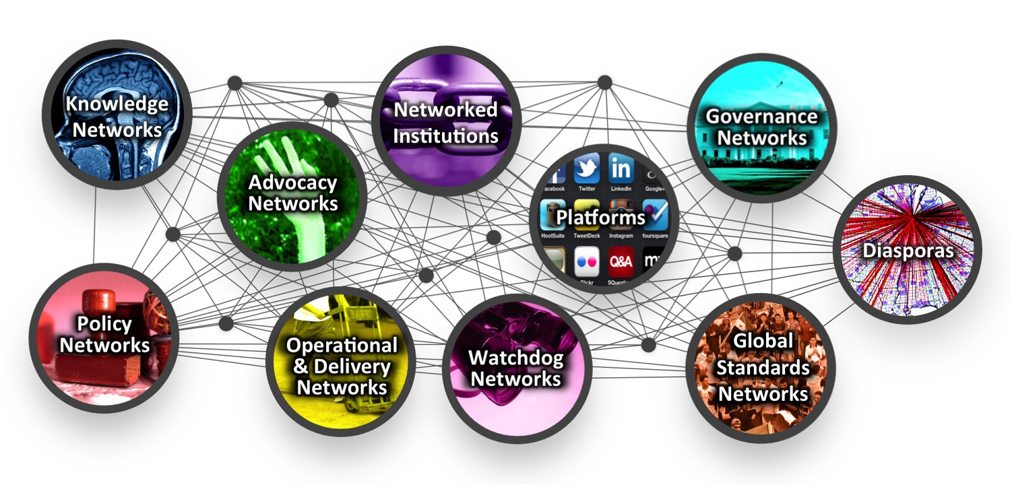
Taxonomy of Global Solution Networks
21 | © 2014 Global Solutions Networks. All Rights Reserved.

Slide 22
Tackling the Hard Issues
Climate Change
Poverty
Conflict
22 | © 2014 Global Solutions Networks. All Rights Reserved.

Slide 23
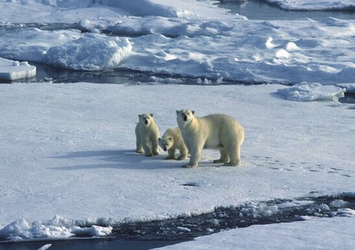
1. Climate Change
23 | © 2014 Global Solutions Networks. All Rights Reserved.

Slide 24
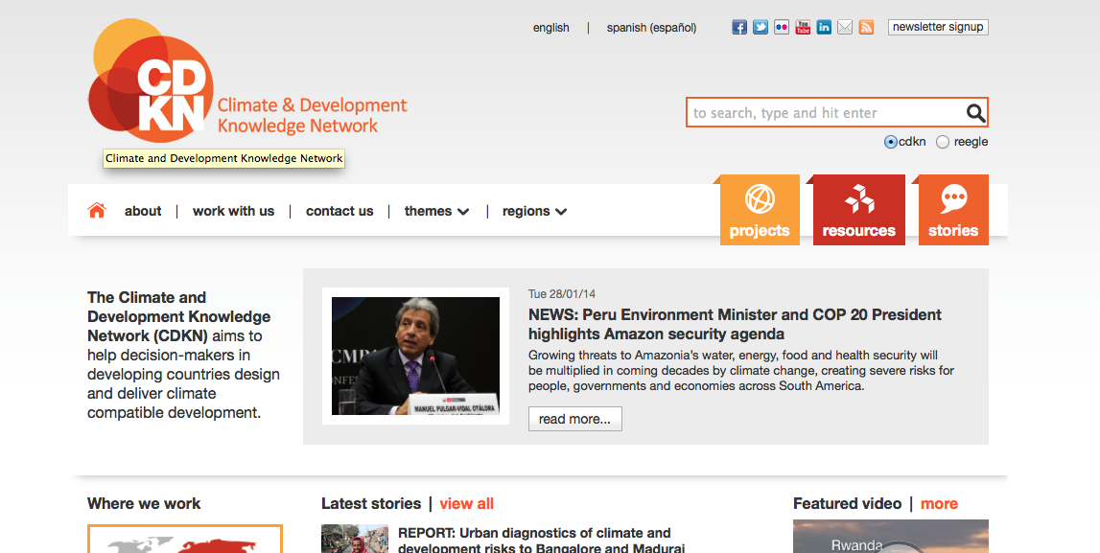
Tackling Climate Change with Knowledge Networks
24 | © 2014 Global Solutions Networks. All Rights Reserved.
cdkn.org
Notes:
The Climate and Development Knowledge Network is a unique collaboration between government, business, and civil society groups that connects climate change and sustainable development experts and ideas in the developed world with those in the developing world, or Global South, much of which is being, and will be, most dramatically affected by the world’s changing climate.
CDKN is able to provide support through its alliance organisations and procure the best services from around the world. They strive to deliver the highest quality technical advice, forge uniquely effective partnerships, and drive the latest and best thinking on climate compatible development. Within the broad scope of climate compatible development, they work across four strategic themes: Climate compatible development strategies and plans, Improving developing countries’ access to climate finance, Strengthening resilience through climate-related disaster risk management and Supporting climate negotiators from the least developed and most vulnerable countries.
Highly dependent on technology – uses web to publish policy briefs, case studies, film and multimedia presentations as well as arrange consultations with remote locations in sustainable development. One of its programs, for example, provides knowledge and technical support for climate-talks negotiators – as well as a forum for collaboration – for some of the poorest and most-affected areas and countries in the world, including The Least Developed Countries Group, the Africa Group of Negotiators, Alliance of Small Island States, and Coalition of Rainforest Nations. This helps the nations that are members of these groups have a more meaningful involvement – and actually get heard around important issues in their regions – at IPCC meetings and in other, traditional international governance institutions.
Knowledge Network: The primary function of Knowledge Networks is to develop new thinking, research, ideas and policies that can be helpful in solving global problems. Their emphasis is on the creation of new ideas, not their advocacy.

Slide 25
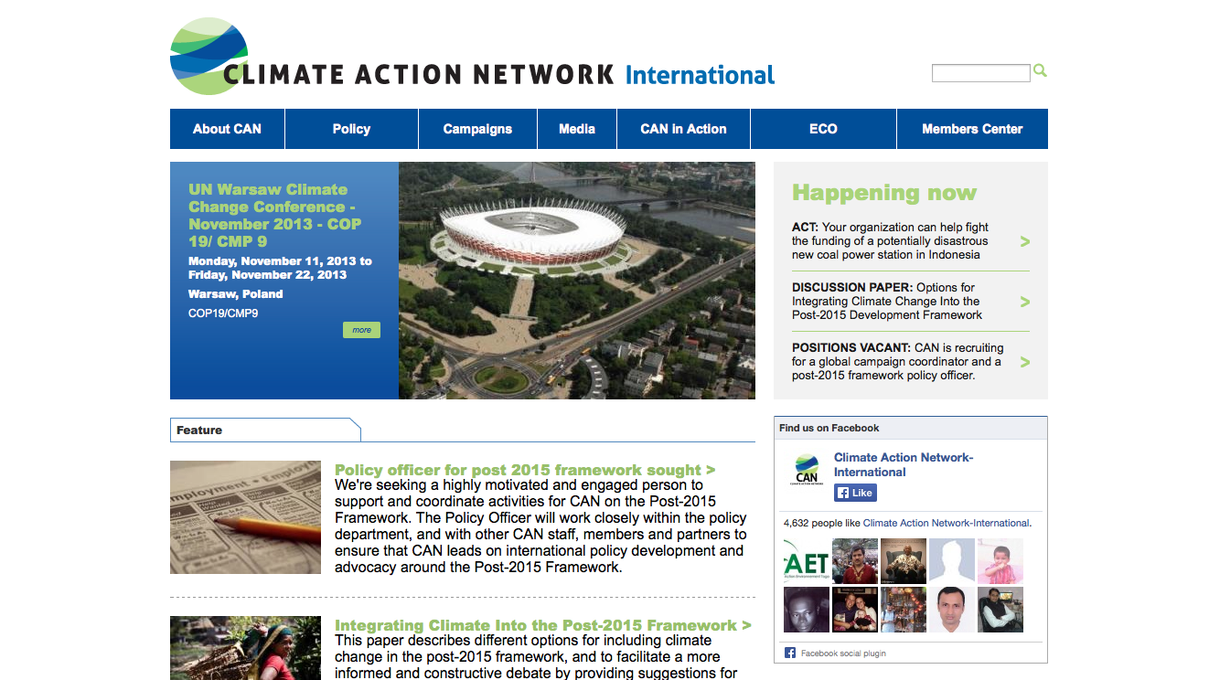
Tackling Climate Change with Operation and Delivery Networks
25 | © 2014 Global Solutions Networks. All Rights Reserved.
climatenetwork.org
Notes:
The Climate Action Network (CAN) is a worldwide network of over 850 Non-Governmental Organizations (NGOs) in more than 90 countries, working to promote government and individual action to limit human-induced climate change to ecologically sustainable levels. CAN members work to achieve this goal through information exchange and the coordinated development of NGO strategy on international, regional, and national climate issues. CAN has regional network hubs that coordinate these efforts around the world. CAN members place a high priority on both a healthy environment and development that "meets the needs of the present without compromising the ability of future generations to meet their own needs" (Brundtland Commission). CAN's vision is to protect the atmosphere while allowing for sustainable and equitable development worldwide.
Mission: To combat climate change, particularly by pressing for comprehensive climate change action plans by all levels of government, based on the best available science, with specific policies, targets, timetables and reporting, and to work with Canada’s governments, First Nations, Inuit and Metis, private sector, labour, and civil society for the effective implementation of these plans.
Operation and Delivery Network: This class of networks actually delivers the change it seeks, supplementing or even bypassing the efforts of traditional institutions.

Slide 26
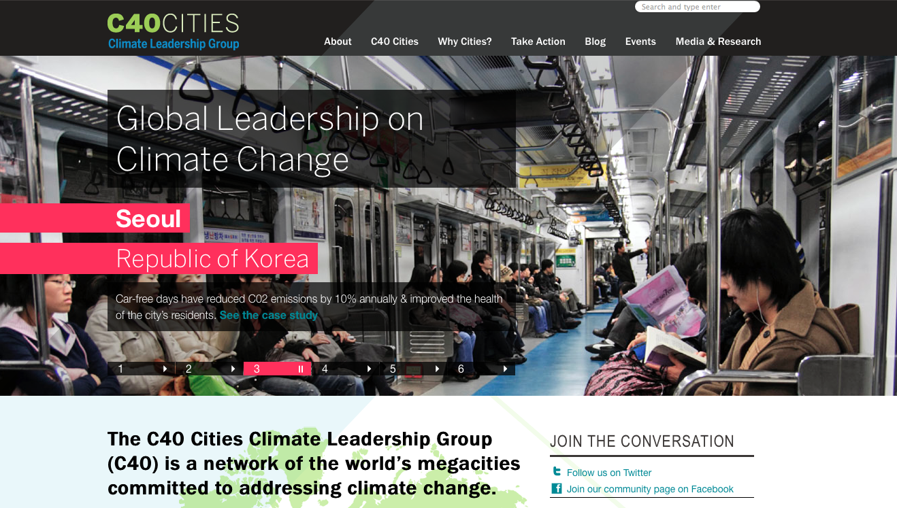
Tackling Climate Change with Policy Networks
26 | © 2014 Global Solutions Networks. All Rights Reserved.
c40.org
Notes:
C40 Cities Climate Leadership Group
It is a network of the world’s megacities taking action to address climate change by developing and implementing policies and programs that generated measureable reductions in both greenhouse gas emissions and climate risks.
Through a partnership with the Clinton Climate Initiative, C40 brings together a unique set of assets and creates a shared sense of purpose. C40 offers cities an effective forum where they can collaborate, share knowledge and drive meaningful, measurable and sustainable action on climate change.
Each city in the C40 is unique in its infrastructure and progress in addressing climate change. C40 works to empower cities to connect with each other and share technical expertise on best practices.
Policy Networks: Sometimes networks create government policy, even though they may consist of non-governmental players. Policy Networks may or may not be created or even encouraged by formal governments or government institutions. Some policy networks support policy development or create an alternative for policy. Policy networks also exist to create and encourage discussions on policy issues.

Slide 27
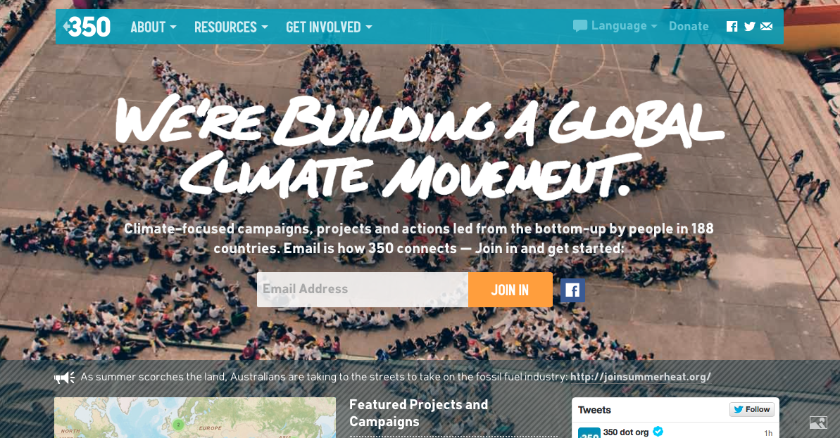
Tackling Climate Change with Advocacy Networks
27 | © 2014 Global Solutions Networks. All Rights Reserved.
350.org
Notes:
350 is a movement more than an organization. They use distributed, grassroots organizing to run adaptive, locally-driven campaigns in every corner of the globe.
They think the climate crisis is about power — but not just the kind of power that runs our cars and keeps the lights on. They believe that the only way we’ll see meaningful action on climate change is if we can counter the power of the fossil fuel industry with the power of people taking collective action. They use online tools to leverage that power, to help those people see themselves as one movement, and to facilitate strategic offline action.
Their online campaigns, grassroots organizing, and mass public action are coordinated by a global network active in over 188 countries. Uses their network to organize coordinated days of action that link activists and organizations around the world.
Advocacy Networks seek to change the agenda or policies of governments, corporations or other institutions.

Slide 28
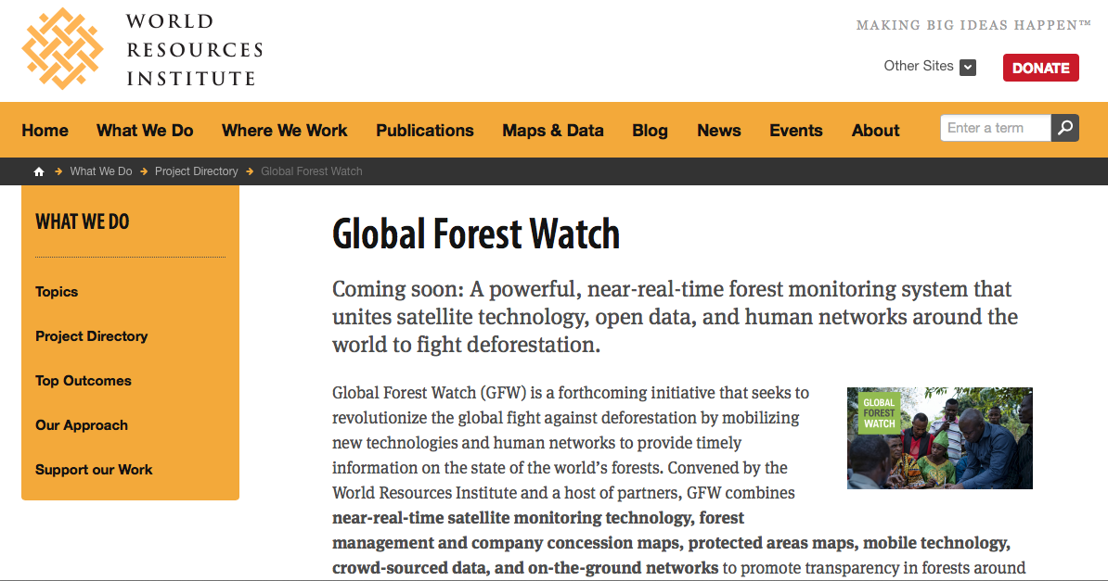
Tackling Climate Change with Watchdog Networks
28 | © 2014 Global Solutions Networks. All Rights Reserved.
wri.org/our-work/project/global-forest-watch
Notes:
Global Forest Watch (GFW) is a forthcoming initiative that seeks to revolutionize the global fight against deforestation by mobilizing new technologies and human networks to provide timely information on the state of the world’s forests. Convened by the World Resources Institute and a host of partners, GFW combines near-real-time satellite monitoring technology, forest management and company concession maps, protected areas maps, mobile technology, crowd-sourced data, and on-the-ground networks to promote transparency in forests around the world.
The GFW platform is intended for use by stakeholders in the world’s forests – concerned citizens, government leaders, buyers and suppliers of sustainable forest products – who seek to better manage forests and improve local livelihoods.
GFW is a watchdog network that improves transparency and accountability in forest management decisions by increasing the public’s access to information on forestry activities around the world. The underlying principle is that increasingly powerful information technologies make transparency one of our most potent mechanisms for strengthening the incentives for responsible industry practices and building the capacity for sustainable forest management.
Watchdog Networks: These networks scrutinize institutions to ensure that they behave appropriately. Topics range from human rights, corruption, the environment, to financial services.

Slide 29
Tackling Climate Change with Platforms
29 | © 2014 Global Solutions Networks. All Rights Reserved.
avaaz.org/en/
Notes:
Avaaz empowers millions of people from all walks of life to take action on pressing global, regional and national issues, from corruption and poverty to conflict and climate change. Our model of internet organising allows thousands of individual efforts, however small, to be rapidly combined into a powerful collective force.
Previous international citizens' groups and social movements have had to build a constituency for each separate issue, year by year and country by country, in order to reach a scale that could make a difference. Today, thanks to new technology and a rising ethic of global interdependence, that constraint no longer applies. Where other global civil society groups are composed of issue-specific networks of national chapters, each with its own staff, budget, and decision-making structure, Avaaz has a single, global team with a mandate to work on any issue of public concern--allowing campaigns of extraordinary nimbleness, flexibility, focus, and scale. Avaaz's online community can act like a megaphone to call attention to new issues; a lightning rod to channel broad public concern into a specific, targeted campaign; a fire truck to rush an effective response to a sudden, urgent emergency; and a stem cell that grows into whatever form of advocacy or work is best suited to meet an urgent need.
Platform: Some networks seek to provide platforms for other networks to organize.

Slide 30
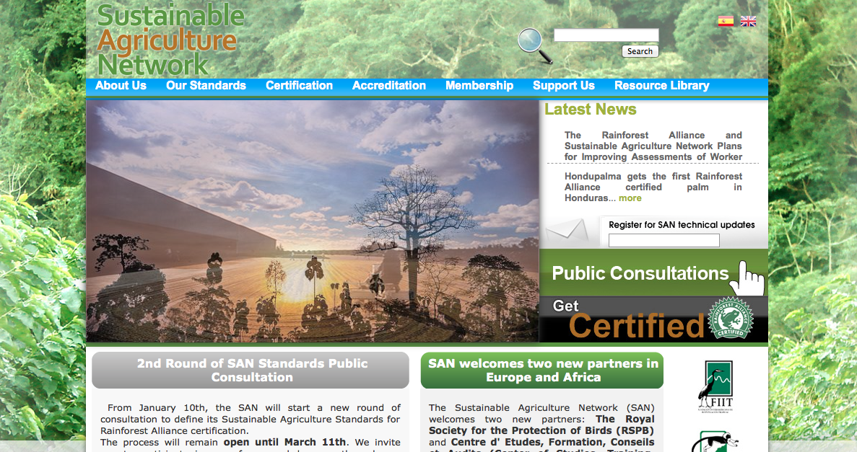
Tackling Climate Change with Global Standards Networks
30 | © 2014 Global Solutions Networks. All Rights Reserved.
sanstandards.org/sitio/
Notes:
The Sustainable Agriculture Network (SAN) promotes efficient and productive agriculture, biodiversity conservation and sustainable community development by creating social and environmental standards. The SAN is a coalition of leading conservation groups that links responsible farmers with conscientious consumers by means of the Rainforest Alliance Certified TM seal of approval. Their collective vision is based on the concept of sustainability, recognizing that the well-being of societies and ecosystems is intertwined and dependent on development that is environmentally sound, socially equitable and economically viable. The SAN develops, manages and owns the Sustainable Agriculture Standard.
The SAN currently includes environmental groups in Brazil, Colombia, Costa Rica, Ecuador, El Salvador, Guatemala, Honduras, India, and Mexico, with many associated academic, agriculture and social responsibility groups around the world. The SAN seeks to transform the environmental and social conditions of agriculture through the implementation of sustainable farming practices. The conservation and rural development groups that manage the certification program understand local culture, politics, language and ecology and are trained in auditing procedures according to internationally recognized guidelines.
Global Standards Networks: Non-state based organizations that develop technical specifications and standards.

Slide 31
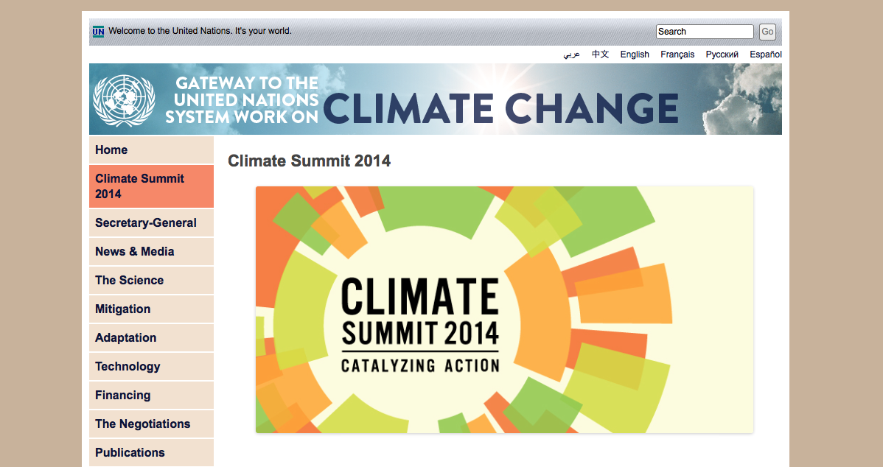
Tackling Climate Change with Governance Networks
31 | © 2014 Global Solutions Networks. All Rights Reserved.
un.org/climatechange/summit2014
Notes:
Climate Summit 2014
http://www.un.org/climatechange/summit2014/
As part of a global effort to mobilize action and ambition on climate change, United Nations Secretary-General Ban Ki-moon is inviting Heads of State and Government along with business, finance, civil society and local leaders to a Climate Summit in September 2014, New York. This Summit will be a different kind of Climate Summit. It is aimed at catalyzing action by governments, business, finance, industry, and civil society in areas for new commitments and substantial, scalable and replicable contributions to the Summit that will help the world shift toward a low-carbon economy.
The Summit will come one year before countries aim to conclude a global climate agreement in 2015 through the United Nations Framework Convention on Climate Change. Although the 2014 Climate Summit is not part of the negotiating process, countries have recognized the value of the Summit, including by welcoming the Secretary-General’s efforts in a Decision of the Doha climate conference in 2012. By catalyzing action on climate change prior to the UNFCCC Climate Change Conference in 2015, the Secretary-General intends to build a solid foundation on which to anchor successful negotiations and sustained progress on the road to reducing emissions and strengthening adaptation strategies.

Slide 32
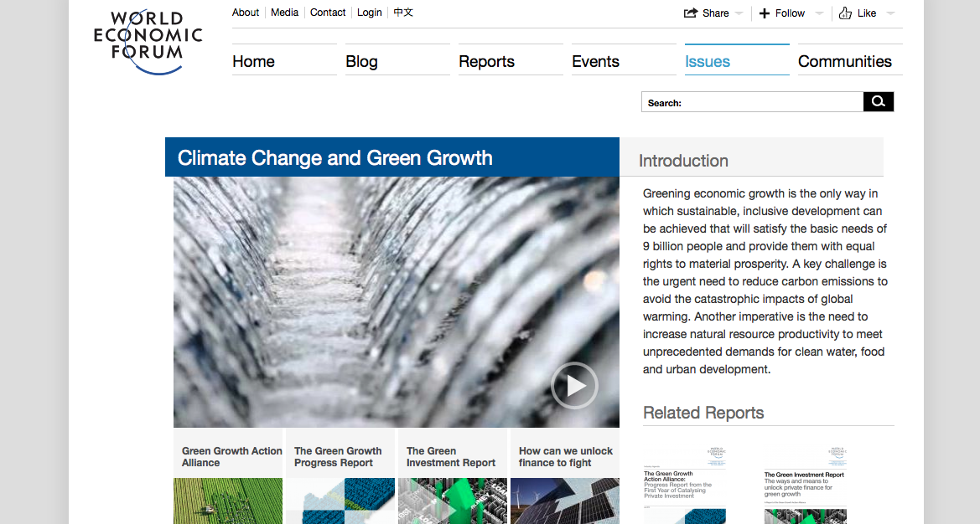
Tackling Climate Change with Networked Institutions
32 | © 2014 Global Solutions Networks. All Rights Reserved.
weforum.org
Notes:
World Economic Forum
Profound political, economic, social and, above all, technological forces are transforming our lives, communities and institutions. Rapidly crossing geographic, gender and generational boundaries, they are shifting power from traditional hierarchies to networked heterarchies. Yet the international community remains focused on crisis rather than strategically driven in the face of the trends, drivers and opportunities pushing global, regional and industry transformation.
“The Reshaping of the World: Consequences for Society, Politics and Business” is therefore the thematic focus of the World Economic Forum Annual Meeting 2014. Our aim is to develop the insights, initiatives and actions necessary to respond to current and emerging challenges.
Networked Institutions: Some networks provide such a wide range of capabilities they could be described as Networked Institutions. They are not state-based but rather true multi-stakeholder networks. But the value they generate can range from knowledge generation, advocacy and policy development to the actual delivery of solutions to global problems.

Slide 33
Tackling Climate Change with Diasporas
33 | © 2014 Global Solutions Networks. All Rights Reserved.

Slide 34
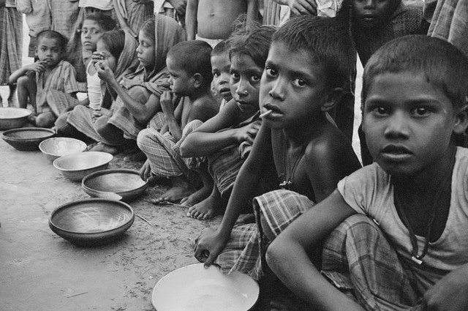
2. Poverty
34 | © 2014 Global Solutions Networks. All Rights Reserved.

Slide 35
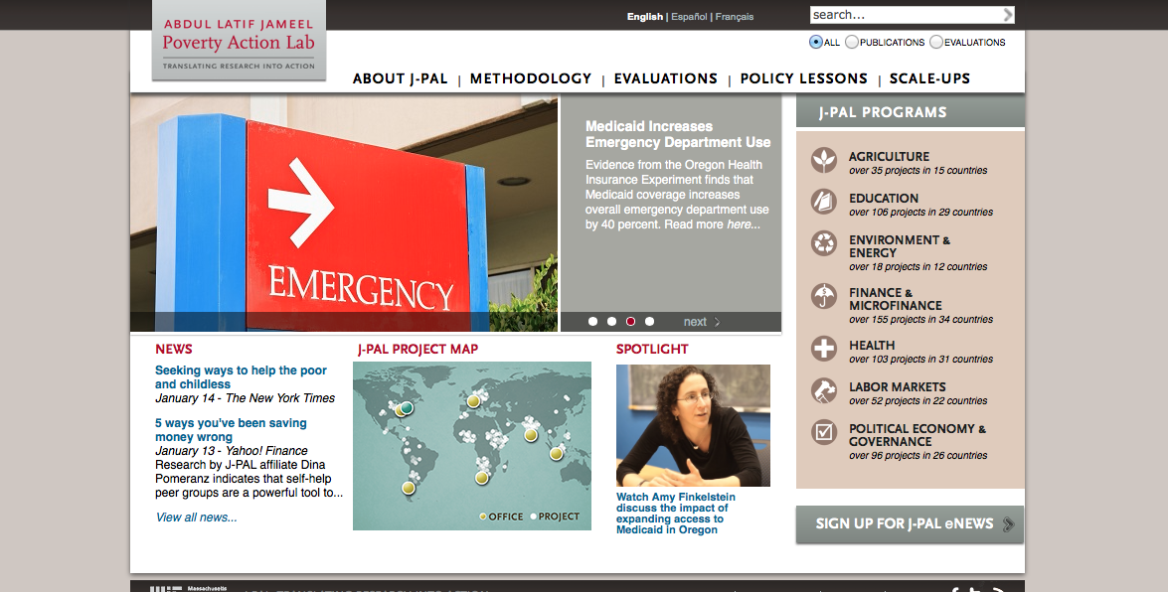
Tackling Poverty with Knowledge Networks
35 | © 2014 Global Solutions Networks. All Rights Reserved.
povertyactionlab.org
Notes:
The Abdul Latif Jameel Poverty Action Lab (J-PAL) was established in 2003 as a research center at the Economics Department at the Massachusetts Institute of Technology. Since then, it has grown into a global network of researchers who use randomized evaluations to answer critical policy questions in the fight against poverty.
J-PAL’s mission is to reduce poverty by ensuring that policy is based on scientific evidence, and research is translated into action. We do this through three main activities:
Conducting Rigorous Impact Evaluations: J-PAL researchers conduct randomized evaluations to test and improve the effectiveness of programs and policies aimed at reducing poverty.
Policy Outreach: J-PAL’s policy group analyzes and disseminates research results and builds partnerships with policymakers to ensure that policy is driven by evidence, and effective programs are scaled up.
Capacity Building: J-PAL equips practitioners with the expertise to carry out their own rigorous evaluations through training courses and joint research projects.
The primary function of Knowledge Networks is to develop new thinking, research, ideas and policies that can be helpful in solving global problems. Their emphasis is on the creation of new ideas, not their advocacy.

Slide 36
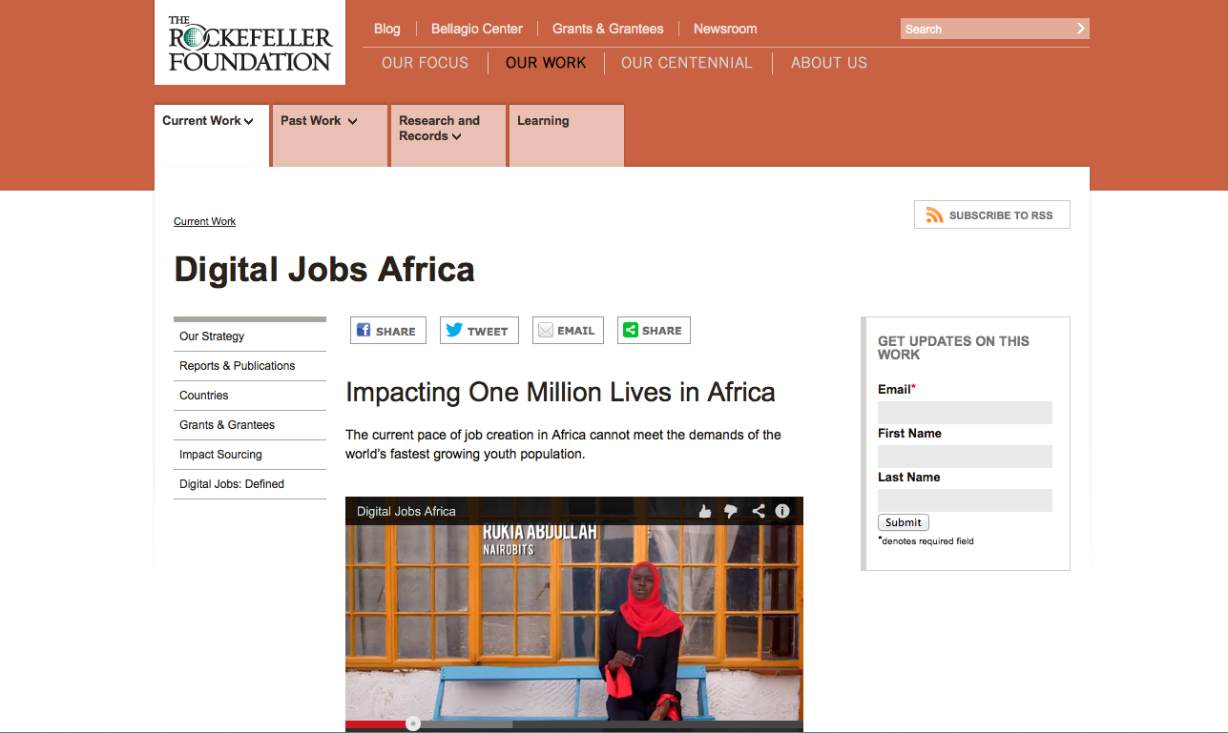
Tackling Poverty with Operational and Delivery Networks
36 | © 2014 Global Solutions Networks. All Rights Reserved.
Notes:
Digital Jobs Africa
Digital Jobs Africa aims to impact 1 million lives in six countries in Africa by catalyzing sustainable Information Communication Technology-enabled (ICT) employment opportunities and skills training for high potential but disadvantaged African youth, thereby generating social and economic opportunities for those employed, their families and communities. The Foundation will work in close partnership with other stakeholders – private sector, government, civil society and the development community – to leverage significant funds and align complementary programs in order to achieve the impact goal.
Digital Jobs Africa will seize the opportunity presented by the youth bulge in Africa and the phenomenal rise of the Information Communication Technology (ICT) sector to bring about sustainable impact, through job creation. To achieve its goal, Digital Jobs Africa will focus on three targeted interventions:
Grow the Impact Sourcing sector by encouraging and enabling the private sector to incorporate the practice into their business model and identify other digital job opportunities beyond Impact Sourcing
Skills development and training to prepare young people for digital jobs such as data entry, service center support, online research, tagging audio and video files, and learning Android and iOS platforms
Support an enabling environment for digital jobs
Operational and Delivery Network: This class of networks actually delivers the change it seeks, supplementing or even bypassing the efforts of traditional institutions.

Slide 37
Tackling Poverty with Policy Networks
37 | © 2014 Global Solutions Networks. All Rights Reserved.
Habitat Jam
Notes:
Habitat Jam was a massive online event organized by the United Nations Human Settlements Programme (UN-HABITAT), the Government of Canada and IBM. It was held on December 1-4 2005 to help solve urgent problems of the world's cities. Habitat Jam was conceived to set the stage for the World Urban Forum 3 conference, which was held in Vancouver in June 2006. Ideas collected through the Jam were used to define themes and shape discussion topics for delegates attending the conference.
The Habitat Jam broke down the barriers of language, literacy, disability, poverty, war and the digital divide to enable over 39,000 people from 158 countries to begin a conversation that some say will change the world.
Participation in Habitat Jam was open to public and private-sector organizations and individuals around the world with an interest in urban issues (poverty, water, sustainability, safety). The diversity of the 39,000 who began the conversation was impressive – slum-dwellers participated alongside government ministers, who participated alongside school children who participated alongside leading academics. The conversation ranged across the issues of poverty, transportation, clean water, governance, and other issues of importance to people living in cities – especially those who are poor.
IBM provided an Internet-based, collaborative environment that could accommodate up to 100,000 participants worldwide. The IBM team customized the Jam application, hosted Habitat Jam, provided advice and guidance to the World Urban Forum organization, analyzed the data collected, participated at the conference, and assisted in public relations and marketing activities. IBM had used online Jams internally since 2001 to enable global collaboration among IBMers. IBM's home-grown Jams are one of the business world's prime examples of collaborative innovation.
Policy Networks: Sometimes networks create government policy, even though they may consist of non-governmental players. Policy Networks may or may not be created or even encouraged by formal governments or government institutions. Some policy networks support policy development or create an alternative for policy. Policy networks also exist to create and encourage discussions on policy issues.

Slide 38
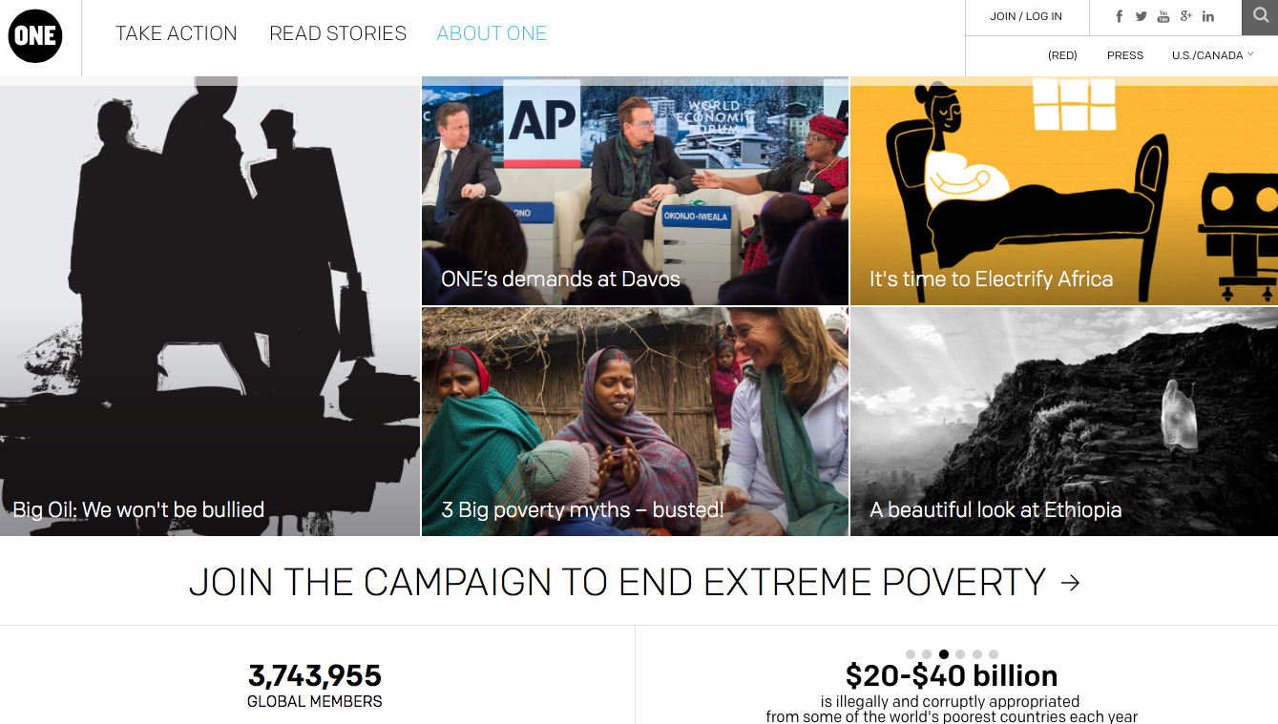
Tackling Poverty with Advocacy Networks
38 | © 2014 Global Solutions Networks. All Rights Reserved.
one.org
Notes:
ONE is a campaigning and advocacy organization of more than 3 million people taking action to end extreme poverty and preventable disease, particularly in Africa… because the facts show extreme poverty has already been cut in half and can be virtually eliminated by 2030, but only if we act with urgency now.
Cofounded by Bono and strictly nonpartisan, we raise public awareness and work with political leaders to combat AIDS and preventable diseases, increase investments in agriculture and nutrition, and demand greater transparency in poverty-fighting programs. ONE also works closely with African activists and policymakers as they fight corruption, promote poverty-fighting priorities, monitor the use of aid, and help build civil society and free enterprise.
ONE is not a grant-making organization and does not solicit funding from the public or receive government funding. ONE is funded almost entirely by a handful of philanthropists and foundations. We achieve change through advocacy -- our teams in Washington, D.C., London, Johannesburg, Brussels, Berlin, and Paris educate and lobby governments to shape policy solutions that save and improve millions of lives.In recent years, ONE’s members, together with other non-profit partners, have played an important role in persuading governments to support effective programs and policies that are making a measurable difference in fighting extreme poverty and disease. As a result of these advocacy efforts, more than 7.5 million people living in Africa today have access to lifesaving AIDS medication, up from only 50,000 in 2002. Malaria has been cut by 75% in eight African countries since 2000, and 51 million more children across sub-Saharan Africa are now going to primary school.
Advocacy Networks seek to change the agenda or policies of governments, corporations or other institutions.

Slide 39
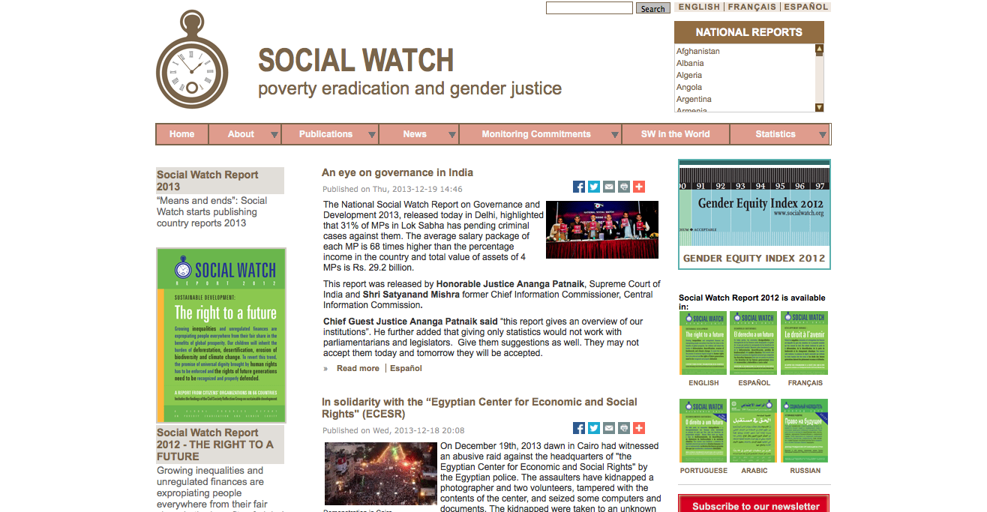
Tackling Poverty with Watchdog Networks
39 | © 2014 Global Solutions Networks. All Rights Reserved.
socialwatch.org
Notes:
Social Watch is an international network of citizens’ organizations in the struggle to eradicate poverty and the causes of poverty, to end all forms of discrimination and racism, to ensure an equitable distribution of wealth and the realization of human rights. They are committed to peace, social, economic, environment and gender justice, and we emphasize the right of all people not to be poor.
Social Watch holds governments, the UN system and international organizations accountable for the fulfilment of national, regional and international commitments to eradicate poverty.
Social Watch will achieve its objectives through a comprehensive strategy of advocacy, awareness-building, monitoring, organizational development and networking. Social Watch promotes people-centred sustainable development.
Watchdog Network: These networks scrutinize institutions to ensure that they behave appropriately. Topics range from human rights, corruption, the environment, to financial services.

Slide 40
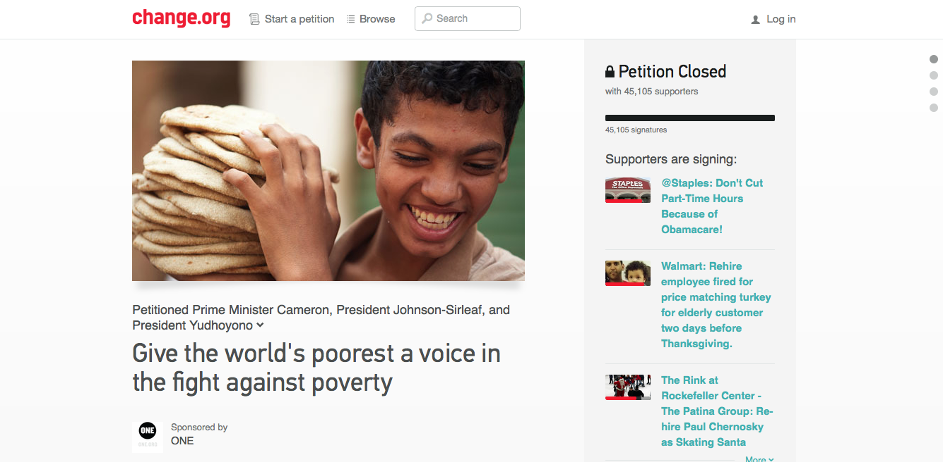
Tackling Poverty with Platforms
40 | © 2014 Global Solutions Networks. All Rights Reserved.
change.org
Notes:
Change.org empowers individuals to pursue social activism by creating online campaigns in support of social causes, from human rights to environmental issues to criminal justice. Founded in 2007, the site brings campaigning into the 21st century by tapping into social media. rather than simply gathering signatures for a petition and moving on, campaigners use social networks such as Facebook and twitter to engage their peers and turn ordinary citizens into active participants in social dialogue.
Whether issues are local or global, change.org uses the power of the Internet to help people reach others in relevant communities. In addition to hosting online petitions, the site also provides support for campaigners by offering tips on topics ranging from building support and engaging supporters to attracting media coverage. Currently growing at a rate of more than 2 million new members each month, change.org is having a significant impact on social issues around the world. The site’s “victories” page provides numerous examples of regular citizens who have successfully brought about change through the network. change.org harnesses technology to make initiating and leading campaigns as simple as possible, while maximizing reach and impact.
Platform: Some networks seek to provide platforms for other networks to organize.

Slide 41
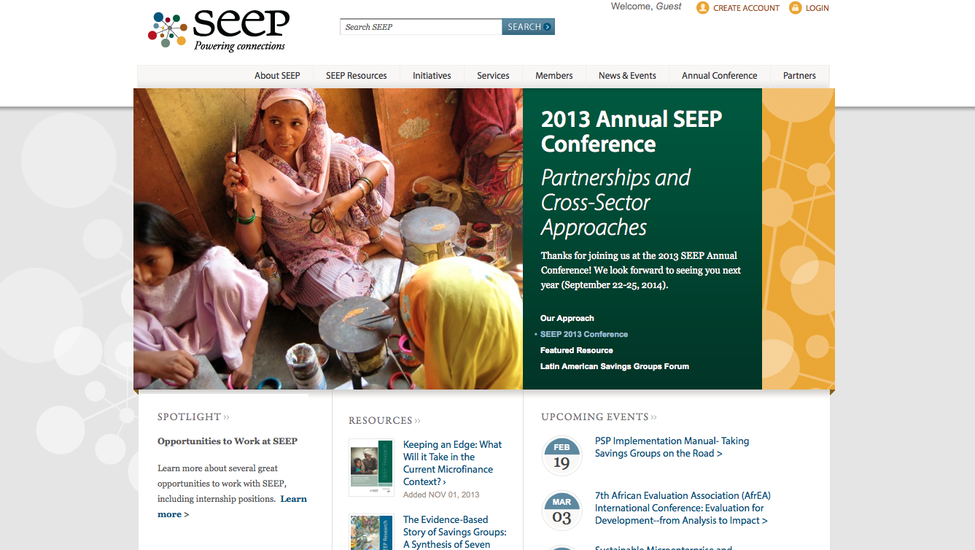
Tackling Poverty with Global Standards Networks
41 | © 2014 Global Solutions Networks. All Rights Reserved.
seepnetwork.org
Notes:
The SEEP Network is a global network of 123 international practitioner organizations dedicated to combating poverty through promoting inclusive markets and financial systems. SEEP represents the largest and most diverse network of its kind, comprised of international development organizations and global, regional, and country-level practitioner networks that promote market development and financial inclusion. Members are active in 170 countries and support nearly 90 million entrepreneurs and their families.
- Knowledge sharing network composed of organizations promoting inclusive financial systems.
-Tests financial inclusion strategies (mostly micro-lending) in settings that will be transferable to many practitioners, shares best practices.
Could be (or become) a standards network, in that they have a benchmarking tool for evaluating microfinance institutions, the Network Capacity Assessment Tool (NCAT)NCAT evaluates institutions on governance, operations, financial viability, human resources, external relations, and service delivery.
- SEEP describes NCAT as “the only globally-recognised assessment methodology for evaluating the institutional capacity of microfinance institutions.”
SEEP member organizations work in 4 critical steps to strengthen the industry:
Identify the most pressing needs of the industry and its clients.
Create highly valuable and relevant learning products by fostering collaboration among SEEP's rich pool of experts.
Disseminate learning to important industry players around the globe through the member base and industry-wide outreach initiatives.
Evaluate existing products and monitor progress in the field.
Global Standards Networks: Non-state based organizations that develop technical specifications and standards.

Slide 42
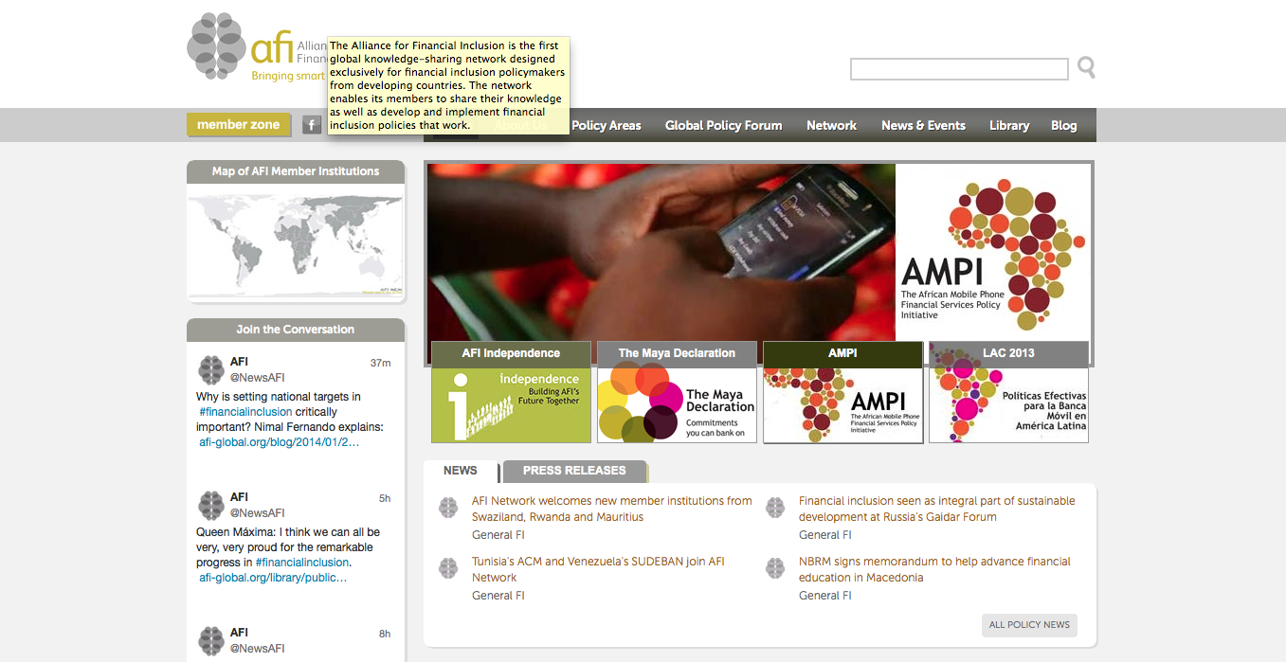
Tackling Poverty with Governance Networks
42 | © 2014 Global Solutions Networks. All Rights Reserved.
afi-global.org
Notes:
Founded with funding from the Bill and Melinda Gates Foundation in 2009.
Network composed of government policymakers from developing countries-- representatives of central banks and regulatory agencies, focused on developing effective financial inclusion policies. Partners with development banks, NGOs, and government and intergovernmental aid agencies. Facilitates working groups, peer exchange and an annual policy forum, towards the goal of implementing policy.
At the 2011 Global Policy Forum 108 member institutions signed on to the Maya Declaration, a statement of principles of financial inclusion--45 of which have followed up with specific policy commitments, and goals (e.g. Zambia has committed to increasing access to financial services to 50% of the population by 2015).
Governance Network: These are multi-stakeholder networks who have achieved or been granted the right and responsibility of non-institutional global governance.

Slide 43
Tackling Poverty with Networked Institutions
43 | © 2014 Global Solutions Networks. All Rights Reserved.
pep-net.org
Notes:
The Partnership for Economic Policy (PEP) is an international organization that links researchers globally to enhance capacity for development policy analysis in developing countries. PEP research contributes to informing national and international debates related to economic policy, poverty, gender and sustainable development.
The core mission of PEP is to provide training and support for developing country researchers to produce reliable scientific evidence and inform relevant policy debates. The unique ‘PEP Grant Plus’ mechanism enables Southern-based researchers to overcome the usual impediments to the conduct of state-of-the-art research within their home countries, despite an often severe lack of resources.
However, with the continual support and interaction of world-leading experts and institutions - globally-linked through this venture - PEP has also become a veritable hub of expertise, knowledge and innovation in the field of economic and development policy analysis in developing countries.
Finally, as a reputed supra-national research institution, PEP also provides the necessary infrastructure for Southern experts to participate in (and bid for) major international initiatives; which, in turn, contributes to establish their national and international reputations and level the playing field with their Northern counterparts. By catalyzing their in-depth knowledge of local contexts, PEP research favours new and more relevant perspectives on major development challenges.
Networked Institutions: Some networks provide such a wide range of capabilities they could be described as Networked Institutions. They are not state-based but rather true multi-stakeholder networks. But the value they generate can range from knowledge generation, advocacy and policy development to the actual delivery of solutions to global problems.

Slide 44
Tackling Poverty with Diasporas
44 | © 2014 Global Solutions Networks. All Rights Reserved.
diasporaalliance.org
Notes:
The International diaspora engagement alliance promotes and supports diaspora-centered initiatives in entrepreneurship, volunteerism, philanthropy, diplomacy, and social innovation in countries and regions of diaspora origin. IdEA is a non-partisan, non-profit organization that engages global diaspora communities, the private sector, civil society, and public institutions in collaborative efforts to support economic and social development.
IdEA opens opportunities for diaspora communities to give back to their countries of origin or ancestry.
Diaspora communities make vital but little-recognized contributions to the progress of their countries of origin or ancestry. They often share goals with governments, businesses, and NGOs.
Common objectives include:
Broad-based economic growth;
Thriving civil society;
Widespread participation in good governance;
Access to global markets for skills and financial capital;
Robust trading partnerships;
Growing participation in science, technology and communication innovations.
Diasporas are global communities formed by people dispersed from their ancestral lands but who share a common culture and sense of strong identity with their homeland. Thanks to the Internet these people and their affiliated organizations can now collaborate in multi-stakeholder networks. One of the functions of many of today diasporas is to address and help solve common, global problems.

Slide 45
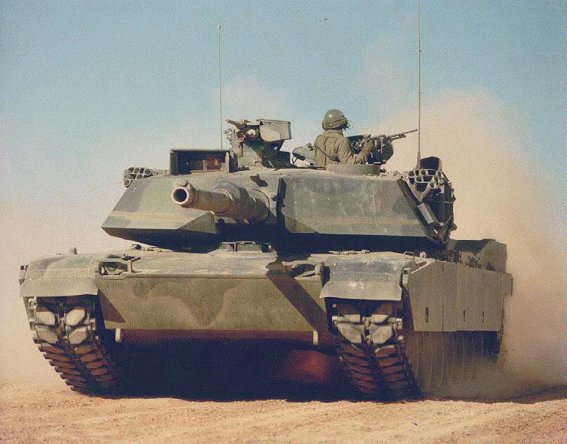
3. Conflict
45 | © 2014 Global Solutions Networks. All Rights Reserved.

Slide 46
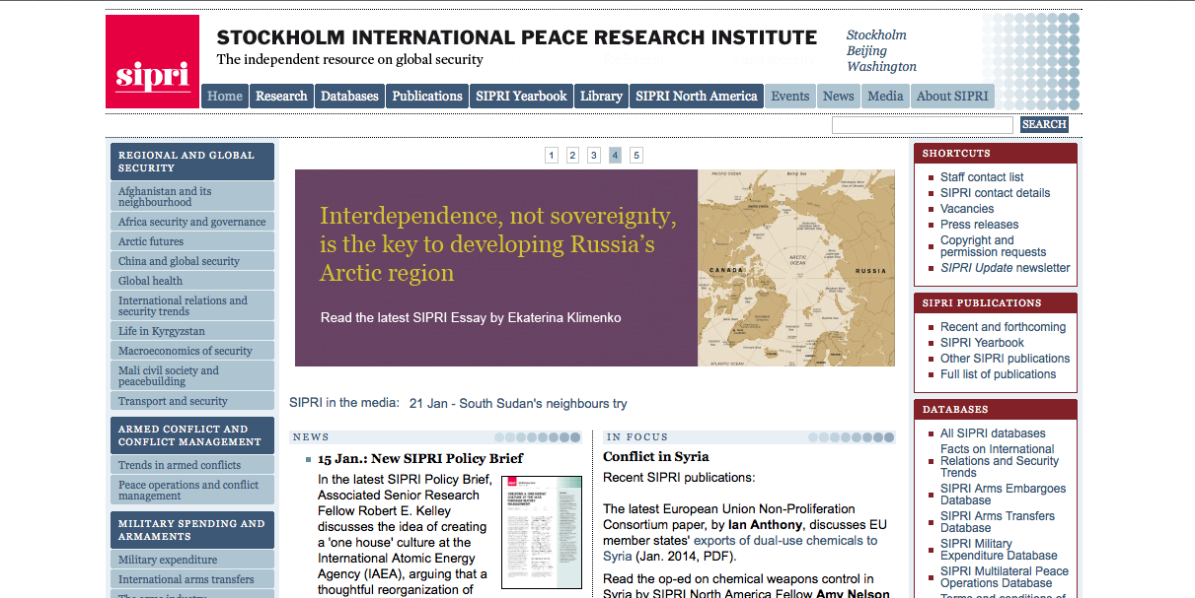
Tackling Conflict with Knowledge Networks
46 | © 2014 Global Solutions Networks. All Rights Reserved.
sipri.org
Notes:
SIPRI is an independent international institute dedicated to research into conflict, armaments, arms control and disarmament. Established in 1966, SIPRI provides data, analysis and recommendations, based on open sources, to policymakers, researchers, media and the interested public. Based in Stockholm, SIPRI also has presences in Beijing and Washington, DC and is regularly ranked among the most respected think tanks worldwide.
SIPRI’s mission is to
Undertake research and activities on security, conflict and peace
Provide policy analysis and recommendations
Facilitate dialogue and build capacities
Promote transparency and accountability
Deliver authoritative information to global audiences
Knowledge Network: The primary function of Knowledge Networks is to develop new thinking, research, ideas and policies that can be helpful in solving global problems. Their emphasis is on the creation of new ideas, not their advocacy.

Slide 47
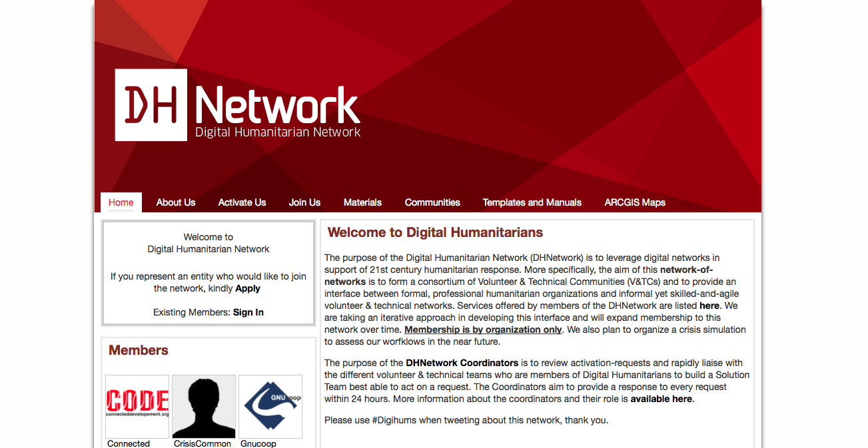
Tackling Conflict with Operational and Delivery Networks
47 | © 2014 Global Solutions Networks. All Rights Reserved.
digitalhumanitarians.com
Notes:
The purpose of the Digital Humanitarian Network is to leverage digital networks in support of 21st century humanitarian response. More specifically, the aim of this network-of-networks is to form a consortium of Volunteer & Technical Communities (V&TCs) and to provide an interface between formal, professional humanitarian organizations and informal yet skilled-and-agile volunteer & technical networks.
Services:
Real-time media monitoring of mainstream and social media
Rapid geo-location of event-data and infrastructure data
Creation of live crisis maps for decision support
Data development and data cleaning
GIS and Big Data analysis
Satellite imagery tagging and tracing
Time-sensitive web-based research
Operational and Delivery Network: This class of networks actually delivers the change it seeks, supplementing or even bypassing the efforts of traditional institutions.

Slide 48
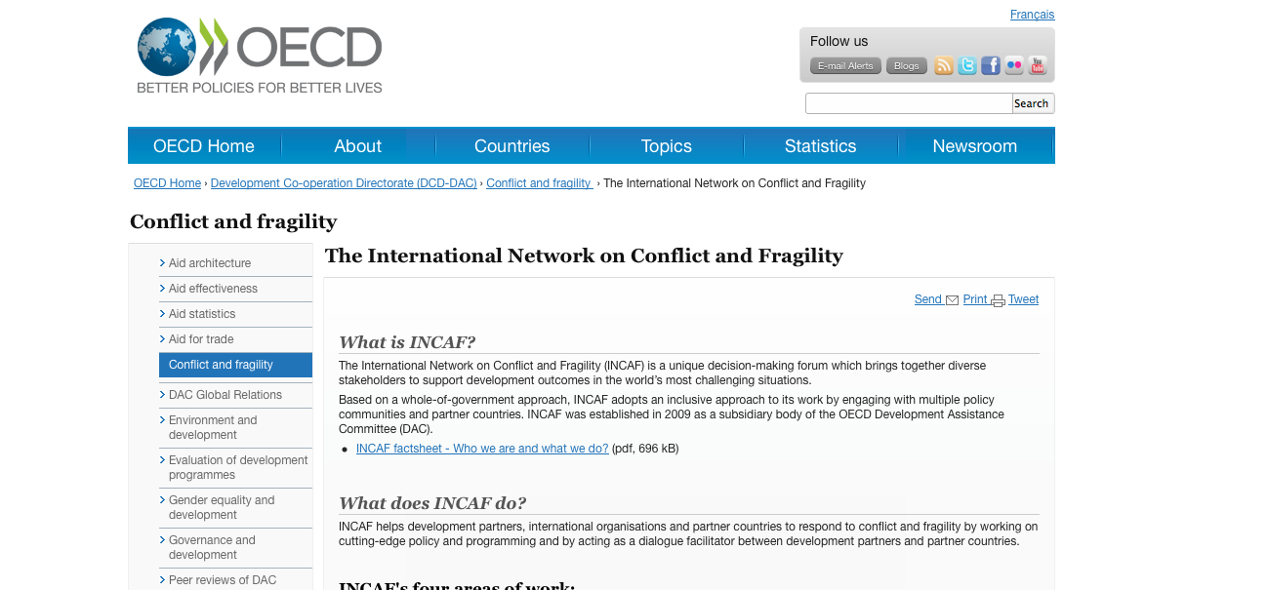
Tackling Conflict with Policy Networks
48 | © 2014 Global Solutions Networks. All Rights Reserved.
oecd.org
Notes:
The International Network on Conflict and Fragility - a unique decision-making forum which brings together diverse stakeholders to support development outcomes in the world’s most challenging situations. Based on a whole-of-government approach, INCAF adopts an inclusive approach to its work by engaging with multiple policy communities and partner countries.
INCAF helps development partners, international organisations and partner countries to respond to conflict and fragility by working on cutting-edge policy and programming and by acting as a dialogue facilitator between development partners and partner countries.
INCAF works with diverse stakeholders including: civil society organisations, development partners, governments, international organisations and partner countries (fragile states in particular). INCAF works in close partnership with the UN, NATO, the World Bank and other bilateral and multilateral agencies dealing with conflict and fragility. It facilitates co-ordination between them and provides a platform for sharing experiences. INCAF also brings together providers of South-South co-operation through consultation and regular dialogue.
Main functions:
Promote lessons learned and good practice in headquarters and in the field
Set international norms and provide guidance to improve donor responses to conflict and fragility
Track results in the field and globally
Policy Networks: Sometimes networks create government policy, even though they may consist of non-governmental players. Policy Networks may or may not be created or even encouraged by formal governments or government institutions. Some policy networks support policy development or create an alternative for policy. Policy networks also exist to create and encourage discussions on policy issues.

Slide 49
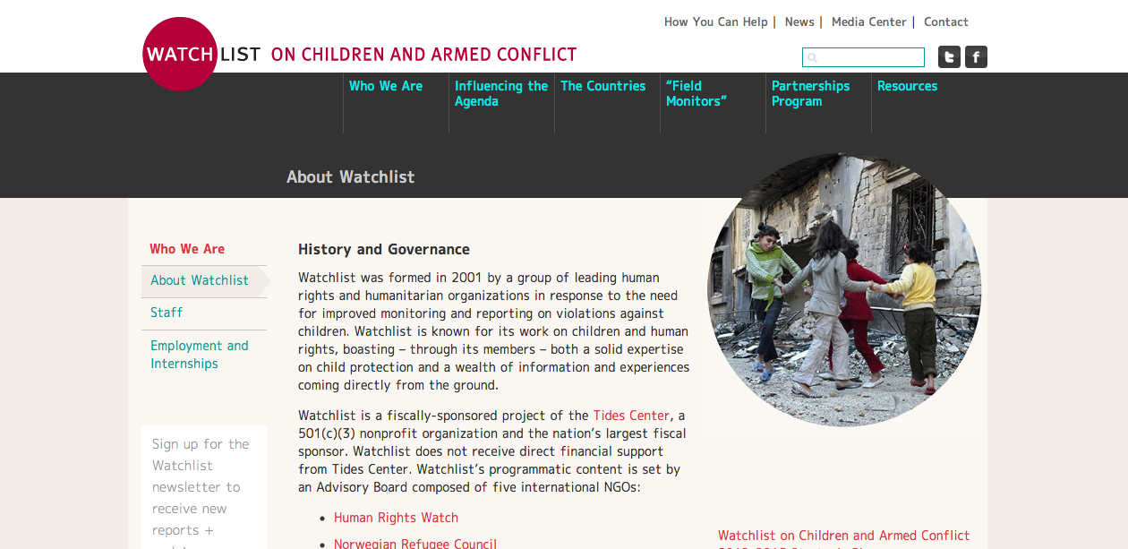
Tackling Conflict with Advocacy Networks
49 | © 2014 Global Solutions Networks. All Rights Reserved.
watchlist.org
Notes:
Watchlist on Children and Armed Conflict
Watchlist was formed in 2001 by a group of leading human rights and humanitarian organizations in response to the need for improved monitoring and reporting on violations against children. Watchlist is known for its work on children and human rights, boasting – through its members – both a solid expertise on child protection and a wealth of information and experiences coming directly from the ground.
Watchlist’s work follows three main program areas:
Monitoring and reporting – We monitor and report on violations in specific countries.
Partner support – We support local organizations to advocate on behalf of children within their own communities.
Advancing the children and armed conflict agenda – We provide policy advice at the highest level to advance the protection of children within the UN’s Children and Armed Conflict framework.
Advocacy Networks seek to change the agenda or policies of governments, corporations or other institutions.

Slide 50
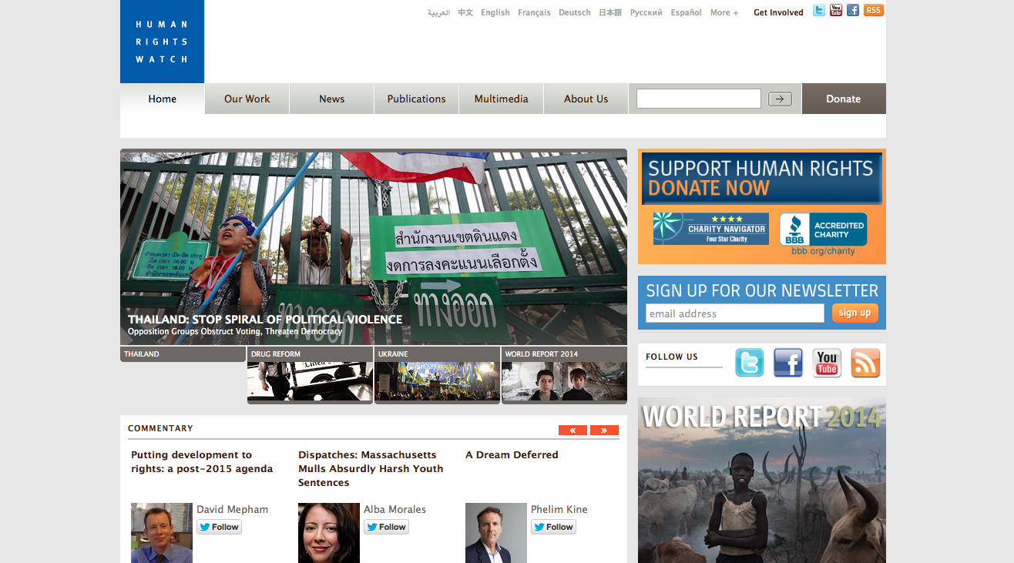
Tackling Conflict with Watchdog Networks
50 | © 2014 Global Solutions Networks. All Rights Reserved.
hrw.org
Notes:
Human Rights Watch is one of the world’s leading independent organizations dedicated to defending and protecting human rights. By focusing international attention where human rights are violated, they give voice to the oppressed and hold oppressors accountable for their crimes. Their rigorous, objective investigations and strategic, targeted advocacy build intense pressure for action and raise the cost of human rights abuse. For more than 30 years, Human Rights Watch has worked tenaciously to lay the legal and moral groundwork for deep-rooted change and has fought to bring greater justice and security to people around the world.
Human Rights Watch is increasingly applying its research methodology to economic, social, and cultural rights, particularly in the areas of education and housing. Human Rights Watch has also begun using statistical research, satellite photography, and bomb-data analysis, among other new methodologies. Combining its traditional on-the-ground fact-finding with new technologies and innovative advocacy keeps Human Rights Watch on the cutting edge of promoting respect for human rights worldwide.
Watchdog Network: These networks scrutinize institutions to ensure that they behave appropriately. Topics range from human rights, corruption, the environment, to financial services.

Slide 51
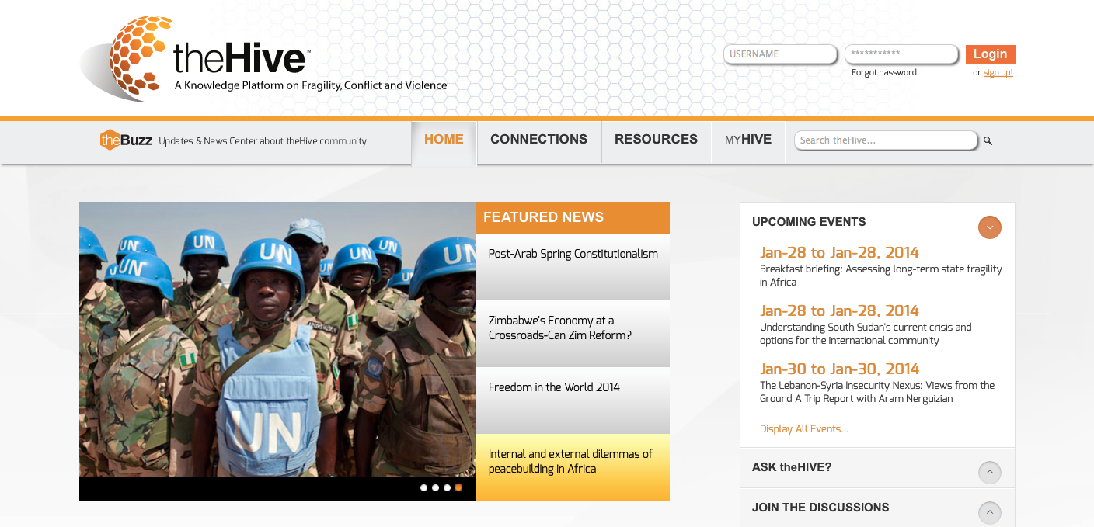
Tackling Conflict with Platforms
51 | © 2014 Global Solutions Networks. All Rights Reserved.
worldbankhive.logicaladvantage.com
Notes:
theHive is a knowledge platform on fragility, conflict, and violence, which provides both an online and face-to-face communication platform for the community of practice working on these issues to share and build knowledge.
theHive aims to achieve the following three objectives:
creating a worldwide community of practice on fragility, conflict and violence
sharing knowledge across contexts and disciplines to bridge divides and reduce isolation; and
connecting new knowledge and innovative approaches that can inform best fit solutions.
Platform: Some networks seek to provide platforms for other networks to organize.
------
Ushahidi
A non profit tech company that specializes in developing free and open source software for information collection, visualization and interactive mapping.
They build tools for democratizing information, increasing transparency and lowering the barriers for individuals to share their stories.
Their roots are in the collaboration of Kenyan citizen journalists during a time of crisis. The original website was used to map incidents of violence and peace efforts throughout the country based on reports submitted via the web and mobile phones. This website had 45,000 users in Kenya, and was the catalyst for realizing there was a need for a platform based on it, which could be used by others around the world.
Since early 2008 they have grown from an ad hoc group of volunteers to a focused organization. Their current team is comprised of individuals with a wide span of experience ranging from human rights work to software development. They have also built a strong team of volunteer developers primarily in Africa, but also Europe, South America and the U.S.
Platform: Some networks seek to provide platforms for other networks to organize.

Slide 52
Tackling Conflict with Global Standards Networks
52 | © 2014 Global Solutions Networks. All Rights Reserved.

Slide 53
Tackling Conflict with Governance Networks
53 | © 2014 Global Solutions Networks. All Rights Reserved.

Slide 54
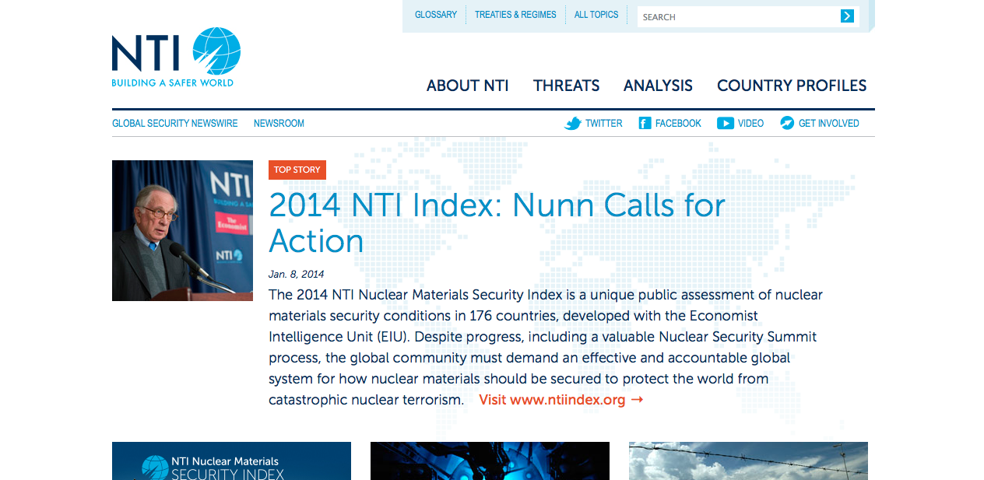
Tackling Conflict with Networked Institutions
54 | © 2014 Global Solutions Networks. All Rights Reserved.
nti.org
Notes:
Nuclear Threat Initiative: a nonprofit, nonpartisan organization with a mission to strengthen global security by reducing the risk of use and preventing the spread of nuclear, biological, and chemical weapons and to work to build the trust, transparency, and security that are preconditions to the ultimate fulfillment of the Non-Proliferation Treaty’s goals and ambitions.
Provides policy advice on how to reduce nuclear proliferation and reduce stockpiles.
Verification Pilot Project brings experts from a dozen countries to establish technical and policy best-practices for verifying compliance with nuclear arms agreements.
Seeks to build international consensus on issues such as the replacement of non-military use of highly enriched uranium with non-weaponizable low enriched uranium, through technical research showing how to make such a change viable.
In a project supported by Warren Buffett, they are creating a seed fund to allow countries building nuclear power plants for the first time to do so using non-weaponizable technology.
Provide benchmarking via their Nuclear Security Index, a measurement of nuclear security in 176 countries.
Networked Institutions: Some networks provide such a wide range of capabilities they could be described as Networked Institutions. They are not state-based but rather true multi-stakeholder networks. But the value they generate can range from knowledge generation, advocacy and policy development to the actual delivery of solutions to global problems.

Slide 55
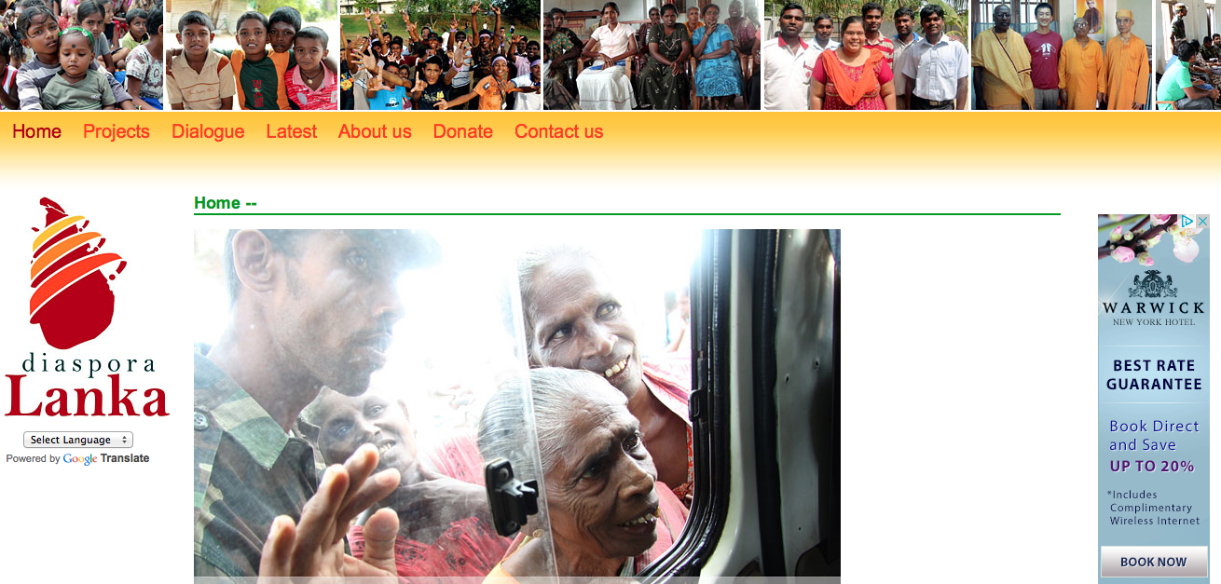
Tackling Conflict with Diasporas
55 | © 2014 Global Solutions Networks. All Rights Reserved.
diasporalanka.org
Notes:
Vision: A unified Sri Lankan diaspora working for the peace and prosperity of Sri Lanka.
Diaspora Lanka actively works towards diaspora unity in Australia as well as restoration efforts in regional Sri Lanka through livelihood support, business development, community advocacy, urban planning and social cohesion initiatives.
Diaspora Lanka’s hopes: “We as a united diaspora, together with our friends, have a unique opportunity to participate in rebuilding, ensuring that the absence of war transforms into a durable peace. Whether Tamil, Muslim, Burgher, Sinhalese or other ethnic group, a sustained peace can be achieved through a diaspora commitment to the future development of Sri Lanka.”
Objectives
Projects: to forge a constructive role for the diaspora in post-conflict Sri Lanka
Reconciliation: to nurture a durable peace both in diaspora countries and in Sri Lanka
Governance: to act as a credible link between the diaspora in Australia and communities in Sri Lanka
Outreach: to collaborate with global diaspora networks committed to a better Sri Lanka
Diapora: Diasporas are global communities formed by people dispersed from their ancestral lands but who share a common culture and sense of strong identity with their homeland. Thanks to the Internet these people and their affiliated organizations can now collaborate in multi-stakeholder networks. One of the functions of many of today diasporas is to address and help solve common, global problems.

Slide 56
Don Tapscott www.gsnetworks.org @dtapscott
56 | © 2014 Global Solutions Networks. All Rights Reserved.

Slide 57
Networking Break
Session will resume in 30 minutes
57 | © 2014 Global Solutions Networks. All Rights Reserved.

Slide 58
Key Stakeholders in Global Problem Solving Panel
Bruce Jenks, former Assistant Secretary General, United Nations Development Programme
Michael Denham, Managing Director, Accenture Canada
Dan Wellers, Global Lead, SAP Center for Business Insight, SAP
Giles Gherson, Deputy Minister of Consumer Services, Government of Ontario
Thomas Debass, Deputy Special Representative for Global Partnerships, US Department of the State
58 | © 2014 Global Solutions Networks. All Rights Reserved.

Slide 59
Lunch
Session will resume at 1:15pm
59 | © 2014 Global Solutions Networks. All Rights Reserved.

Slide 60
One Year Later: Stories and Insights
About Global Solution Networks & More
Anthony D. Williams
Executive Editor
Global Solution Networks
60 | © 2014 Global Solutions Networks. All Rights Reserved.

Slide 61
Where do GSNs come from?
How do they evolve?
61 | © 2014 Global Solutions Networks. All Rights Reserved.

Slide 62
Sometimes peaceful and productive solutions emerge from a war of opposing forces
62 | © 2014 Global Solutions Networks. All Rights Reserved.
Notes:
World Wide Fund for Nature and Unilever.

Slide 63
GSNs often evolve through an evolutionary process of dialogue and negotiation among stakeholders
63 | © 2014 Global Solutions Networks. All Rights Reserved.
Notes:
World Wide Fund for Nature and Unilever.

Slide 64
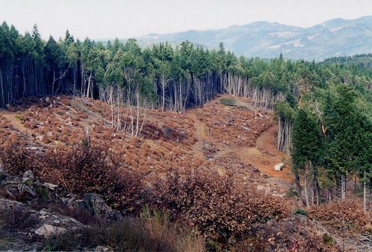
First there was the Forest Stewardship Council --
then there was FSC-Watch
64 | © 2014 Global Solutions Networks. All Rights Reserved.
Notes:
World Wide Fund for Nature and Unilever.

Slide 65
Network inception stories suggest both endogenous and exogenous drivers are at work
65 | © 2014 Global Solutions Networks. All Rights Reserved.

Slide 66
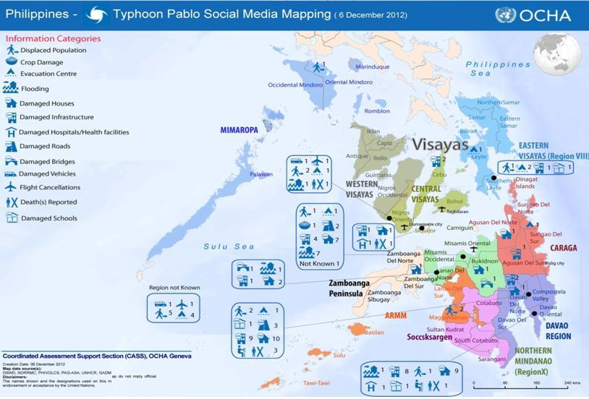
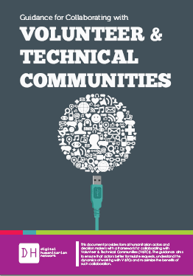
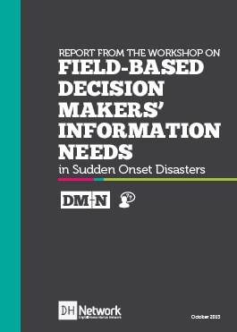
Networks with high values alignment and high internal motivation are likely to have the highest impact
66 | © 2014 Global Solutions Networks. All Rights Reserved.
Notes:
the Digital Humanitarian Network, a “network of networks” that builds effective partnerships between humanitarian relief agencies and the diverse volunteer communities that have been involved in crisis-mapping emergency situations such as the earthquake in Haiti.
The Haiti earthquake of 2010 radically changed the way information is collected and analyzed in humanitarian emergencies. New technologies were used to collect and organize data from multiple sources moments after the disaster. Much of this work—including media tracking, geolocation, mapping, data cleaning, translation, and social-networks monitoring—was done by volunteers working from their homes and offices around the world. Throughout the relief operations, V&TCs col-lected, verified and analyzed more data than humanitarian teams in the field had the capacity to process.

Slide 67
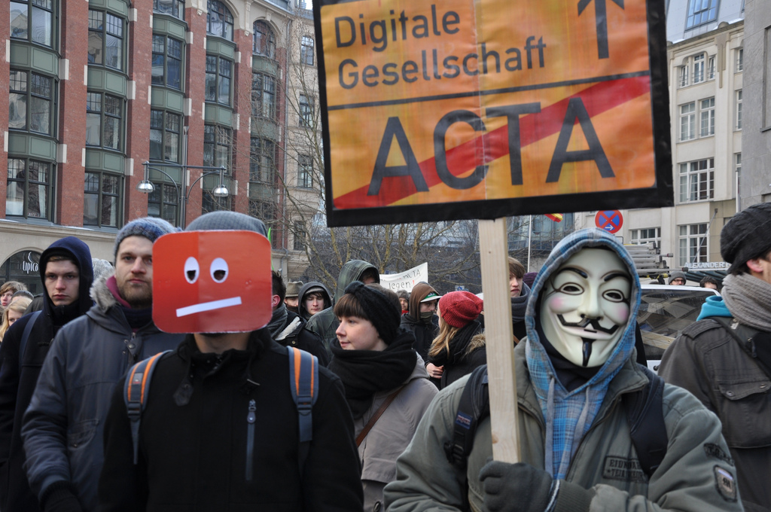
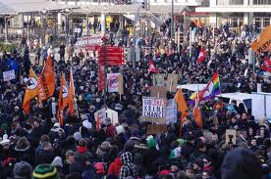
GSNs form in increasingly unpredictable ways, and can have unpredictable impacts
67 | © 2014 Global Solutions Networks. All Rights Reserved.

Slide 68
What have we learned about some of the
specific network types?
68 | © 2014 Global Solutions Networks. All Rights Reserved.

Slide 69
Knowledge Networks build a transparent evidence base for understanding & resolving issues with stakeholders
69 | © 2014 Global Solutions Networks. All Rights Reserved.

Slide 70
Knowledge Networks leaders are harnessing the wiki paradigm, but the majority are not
70 | © 2014 Global Solutions Networks. All Rights Reserved.

Slide 71
Standards Networks sound boring on the surface, but are fundamentally important to global problem solving
71 | © 2014 Global Solutions Networks. All Rights Reserved.

Slide 72
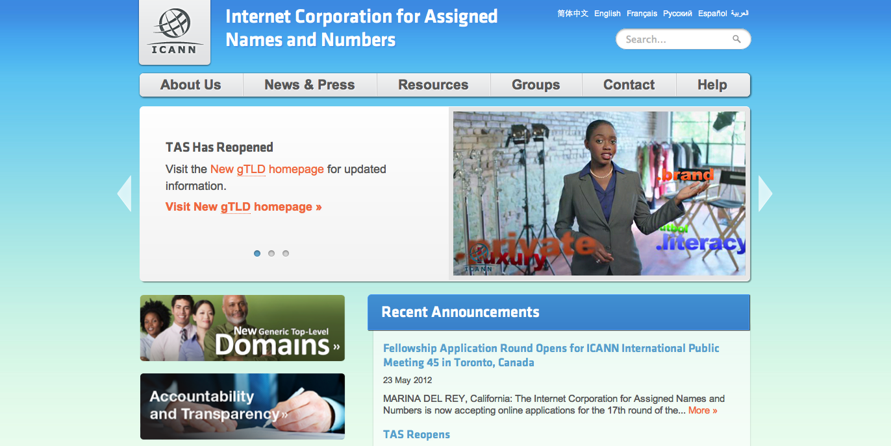
Governance Networks have varying degrees of governance, contrasting models based on soft versus hard power
72 | © 2014 Global Solutions Networks. All Rights Reserved.

Slide 73
Advocacy Networks are often deemed ineffective in creating change, which ignores their role in increasing awareness
73 | © 2014 Global Solutions Networks. All Rights Reserved.
Notes:
Advocacy networks are often judged to be ineffective in generating change, which ignores their objective of increasing awareness. It is difficult to measure the success of activism that seeks to better inform the audience about issues and challenges in a very complicated world. Simply disseminating information and encouraging members to extend the reach of the network through their own social contacts can be extremely effective in creating groundswells of action and changes of behavior. From 350.org’s experience, it is clear that Advocacy networks play vital roles in addressing complex global issues like climate change. But in light of the slow progress on climate change solutions, there is an argument to be made that 350.org has relied too heavily on defining its successes in terms of concrete changes in government policy. Less tangible, but arguably just as critical successes may have resulted from focusing attention of a large and well-networked populace on the issues of climate change.

Slide 74
Policy Networks are failing to exploit the potential for genuine citizen engagement, despite available tools
74 | © 2014 Global Solutions Networks. All Rights Reserved.

Slide 75
Platforms are least likely to be “multi-stakeholder” but are critical to enabling self-organizing problem-solving networks
75 | © 2014 Global Solutions Networks. All Rights Reserved.
Notes:
Platforms. Open data.

Slide 76
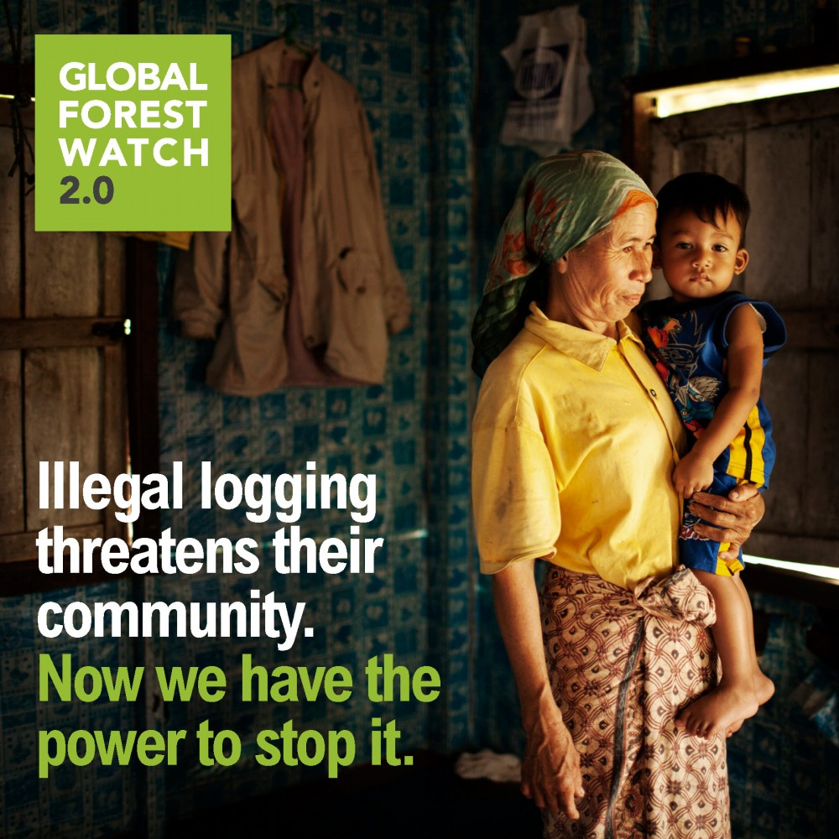
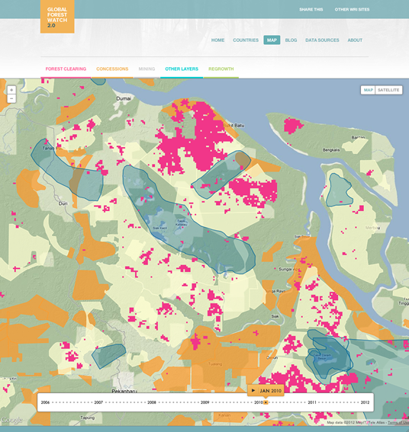
Watchdog Networks are the most dynamic users of technology, and furthest ahead in real-time data analysis
76 | © 2014 Global Solutions Networks. All Rights Reserved.

Slide 77
Watchdog Networks and local crowdsourcing makes for a powerful combination that can amplify reach & impact
77 | © 2014 Global Solutions Networks. All Rights Reserved.
Notes:
GSNs can combine satellite monitoring and remote sensing with local crowdsourcing efforts to engage the public. In fact, the combination of these methods provides a powerful way to capture local irregularities and issues that are impossible to detect remotely. GFW has recognized, for example, that while visual maps and computer algorithms can help detect deforestation patterns, there is no substitute for local knowledge and on-site intelligence when it comes to identifying the source of deforestation. The same is true in other domains, including biodiversity and water. Project Noah’s detailed maps displaying biodiversity around the planet wouldn’t be possible without the on-the-ground photos and reports contributed by its global network of nature watchers. And as Sara Boettiger noted in her report on Global Solution Networks and New Tools for Tackling Poverty, GSNs are working all over the world to address water quality and water supply issues, and crowdsourcing features prominently in the toolkit of effective approaches. In addition to the Akvo FLOW case featured earlier, IBM worked with the government of South Africa in 2013 to create a crowdsourcing platform that allows users to report problems with water pipes and leaks, and generally comment on the delivery of water. In Berlin, WaterWatcher is another a simple, cheap test of water quality that interfaces with your mobile phone. “South Africa: Crowdsourcing to Tackle SA Water Leaks.” AllAfrica. 25 March 2013. Web. 18 May 2013

Slide 78
How is technology enabling
global problem solving?
78 | © 2014 Global Solutions Networks. All Rights Reserved.

Slide 79
World-changing technologies emerging at a rapid pace
79 | © 2014 Global Solutions Networks. All Rights Reserved.

Slide 80
When it comes to solving global problems, the most advanced technologies are not always the best ones
80 | © 2014 Global Solutions Networks. All Rights Reserved.
Notes:
Technology solutions do not need to be cutting-edge to be effective. Sometimes gSNs put the technology first and design a program or solution to fit the delivery method. DSH does the reverse, building a program and pedagogical approach and choosing an appropriate technology platform to deliver it. as a result, the technology deployed by DSH would be considered obsolete, even quaint in most parts of the world. Streaming video is replacing DVDs (and all physical media) and basic mobile handsets are ubiquitous, even in impoverished areas. Still, the mandate of DSH is better served with simpler technology given its mission, infrastructure and cost limitations. Basic handsets and limited wireless bandwidth, after all, will not yet support video-based content delivery. DSH will only consider switching to more advanced delivery platforms once economics and infrastructure have evolved sufficiently to ensure that its pedagogical approach will not be compromised.

Slide 81
The mobile phone is the most talked about technology for GSNs, and for good reasons
81 | © 2014 Global Solutions Networks. All Rights Reserved.

Slide 82
Mobile phones empower citizen journalists and human rights activists to bear witness
82 | © 2014 Global Solutions Networks. All Rights Reserved.

Slide 83
Mobile phones are at the center of efforts to provide financial services to the world’s unbanked citizens
83 | © 2014 Global Solutions Networks. All Rights Reserved.
Notes:
Mobile banking is one of the most compelling examples of leapfrogging, where a lack of robust financial infrastructure in developing countries has led to some remarkable financial ingenuity. In Kenya, for example, M-Pesa became the first mobile money transfer service, making it easy for anyone with a cell phone to send and receive cash. Run by Safaricom, a Kenyan mobile-phone operator, the service is overwhelmingly popular, with 15 million subscribers (from an adult population of 43 million) who use it for everything from paying electricity bills to school fees. Thanks to a simple text-based menu, M-Pesa is accessible on even the most basic mobile phone.
In 2013, Safaricom rolled out a complementary savings and loan service called M-Shwari. The service, which can be set up instantly and accessed on any device, promises to extend financial services to a large population of Kenyans that were previously excluded. Bob Collymore, Safaricom’s chief executive, believes that Kenya’s unbanked sector could have savings of $3.4 billion, much of it stuffed in jars or mattresses, earning nothing and at the mercy of thieves. M-Shwari acquired 2.3 million customers in its first four months, one-third of whom have applied for small business loans, averaging around $12.

Slide 84
Mobile phones have become a key channel for accessing public services, especially for rural villagers
84 | © 2014 Global Solutions Networks. All Rights Reserved.
Notes:
Mobile technology gets critical services into hard to reach communities. Even simple mobile technology can dramatically improve the services on offer. The fact that mobile phone networks often surpass other infrastructure such as paved roads and electricity means the operational and delivery networks can reach rural and fragmented communities with services and facilities that they could not easily serve otherwise.

Slide 85
Mobile phones offer considerable potential for improving access to health services
85 | © 2014 Global Solutions Networks. All Rights Reserved.
Notes:
While no panacea, innovative mobile health strategies and solutions provide an opportunity rethink and reshape many aspects of health care delivery in developed and developing countries alike. For example, SMS alerts can remind patients to take their prescription drugs at the appropriate time. Frontline health workers with mobile devices can offer remote diagnosis and even treatment for patients who do not have easy access to a physician. Wireless health monitoring devices can track patients’ conditions remotely and relay information back to central databases that are monitored by clinicians, thereby improving treatment compliance, preventing the need for costly hospital visits (except in emergency situations) and improving quality of life for patients with chronic conditions.
Delivering mobile-assisted awareness programs to pregnant mothers and traditional birth attendants, for example, has been found to reduce prenatal and maternal mortality by up to 30 per cent. In fact, recent studies suggest that mHealth initiatives in Africa could save millions of lives annually. A recent report by PricewaterhouseCoopers India concluded that mobile phone interventions to ensure patients comply with treatment, medical stock is available and healthcare workers stick to treatment guidelines could save some of the three million lives lost each year across Africa to HIV/AIDS, tuberculosis and malaria.

Slide 86
But… mobile services for the poor should be bundled with education and capacity building
86 | © 2014 Global Solutions Networks. All Rights Reserved.
Notes:
Services for the poor should be bundled with education. The hazards of providing financial services, especially credit products, to individuals that have not had experience with banking, saving, credit and insurance are obvious. Short-term earning requirements of large stakeholders need to be kept in check and the consumers need thorough support and training in the use of the products. It is of critical importance that new markets in areas of poverty are developed with long- term interests in mind and that the new consumers of the financial services products are protected from exploitation and provided with adequate training so that they may benefit rather than suffer from the actions of large operators.

Slide 87
Data generated by mobile phones provide important
insights into why problems occur and how to solve them
87 | © 2014 Global Solutions Networks. All Rights Reserved.
Notes:
Conventional public health strategies for combating malaria rely on sending teams of epidemiologists into the field. But epidemiologist Caroline Buckee spends most of her time examining the anonymized cell phone records of 15 million Kenyans. According to Buckee, just studying one particular cell phone tower near the town of Kericho in Kenya’s western highlands represents the equivalent of epidemiological gold.
When she and her colleagues studied the data, she found that people making calls or sending text messages originating at the Kericho cell tower were making 16 times more trips away from the area than the regional average. What’s more, they were three times more likely to visit a region northeast of Lake Victoria that records from the health ministry identified as a malaria hot spot. The tower’s signal radius thus covered a significant waypoint for transmission of malaria, which can jump from human to human via mosquitoes. Satellite images revealed the likely culprit: a busy tea plantation full of migrant workers, a large proportion of whom were likely infected with malaria.
Buckee’s work is now feeding into a new set of predictive models. The models show, for example, that even though malaria cases were seen at the tea plantation, taking steps to control malaria there would have less effect on the disease’s spread than concentrating those efforts at the source: Lake Victoria. That region has long been understood as a major center of malaria, but what hasn’t been available before is detailed information about the patterns of human travel there: how many people are coming and going, when they’re arriving and departing, which specific places they’re coming to, and which of those destinations attract the most people traveling on to new places.
The data mining will also help inform the design of new measures that are likely to include cheap, targeted campaigns of text messages—for example, warning visitors entering the Kericho tower’s signal zone to use bed netting. And it will help officials choose where to focus mosquito control efforts in the malarial areas.

Slide 88
The real-time data generated by the Internet of Everything is even bigger and more mind boggling
88 | © 2014 Global Solutions Networks. All Rights Reserved.
Notes:
“Big Data” was coined for a good reason: today’s datasets are getting so large and complex that conventional tools for collecting, storing, analyzing and visualizing them have been rendered insufficient. Indeed, the real challenge for scientists and others engaged in global public policy issues is not just collecting the relevant data, but analyzing and making sense of it. And not just each individual data stream in isolation, but the larger emergent patterns arising out of the cacophony of information we are constantly assembling. Big data is already driving the need for advanced artificial intelligence that can detect patterns that the human mind cannot. But perhaps one of the more intriguing results of the big data revolution is that the research and public policy community increasingly recognizes that no one scientist, team or organization has the scale to create and curate the deluge of data on its own. In other works, big data is driving the need for global solution networks. In fact, global knowledge networks and research organizations have little choice but to pool the financial and human resources necessary to undertake these large-scale projects. One of the first priorities for GSNs should therefore be to build data sharing and capacity building alliances among networks that are operating in data intensive fields.

Slide 89
GSNs will need data scientists and must invest in data literacy training
89 | © 2014 Global Solutions Networks. All Rights Reserved.
Notes:
the UN Global Pulse team found that analyzing Twitter messages can give an early warning of a spike in unemployment, price rises and disease. Such “digital smoke signals of distress” usually come months before official statistics — and in many developing countries today, there are no reliable statistics. Research found, for example, that surges in online mentions of rice prices accurately captured price increases several months before official reports.
GSNS will need data scientists and must invest in data literacy training. Basic data literacy is assumed amongst scientists, but the general population has nowhere near the level of data literacy that will be required in most professions in the near future. And the same can be said of the vast majority of organizations that participate in global solution networks, with the UN Global Pulse team representing a rare exception. Even in science, recent developments have upped the ante. To do path-breaking science, scientists need to be fluent in large-scale data analytics or partner with someone who is. Similarly, skills in managing, presenting and extracting insight from data will be increasingly valuable in the business of solving the world’s problems. Indeed, it will be increasingly difficult to convince anyone—citizens, governments or corporations—of the need to change behavior in the absence of convincing data. Accordingly, GSNs will need to foster data literacy within their memberships through workshops and training sessions and should also work with organizations such as Global Pulse to cultivate an interest in global problem solving among the broader community of data scientists.

Slide 90
How can you start building a
GSN of your own?
90 | © 2014 Global Solutions Networks. All Rights Reserved.

Slide 91
Find an honest broker or “orchestrator” who can convene a network of stakeholders to solve a problem
91 | © 2014 Global Solutions Networks. All Rights Reserved.
Notes:
Putting data on an open platform can enable GSNs to unleash powerful problem solving networks. When the World Bank opened up its immense collection of data on a wide range of development indicators, it transformed a closed resource that only a privileged few could access into a platform that supports a diverse community of problem solvers who leverage the data to create new knowledge and innovations. By open sourcing their approach, and particularly their data, GSNs can stay more attuned to emerging issues and social expectations and can also leverage the complementary resources and capabilities needed to address them. GSNs should also learn to harness the open data platforms provided by governments and international institutions.

Slide 92
Open up valuable resources that other stakeholders can contribute to and build on
92 | © 2014 Global Solutions Networks. All Rights Reserved.
Notes:
Putting data on an open platform can enable GSNs to unleash powerful problem solving networks. When the World Bank opened up its immense collection of data on a wide range of development indicators, it transformed a closed resource that only a privileged few could access into a platform that supports a diverse community of problem solvers who leverage the data to create new knowledge and innovations. By open sourcing their approach, and particularly their data, GSNs can stay more attuned to emerging issues and social expectations and can also leverage the complementary resources and capabilities needed to address them. GSNs should also learn to harness the open data platforms provided by governments and international institutions.

Slide 93
Launch a challenge around an intractable problem; build on the ideas and networks it generates
93 | © 2014 Global Solutions Networks. All Rights Reserved.
Notes:
Over the last decade," she noted, "things have changed a lot at MIT. We now have classes where hundreds of students are working to solve poverty issues with people from around world, not just for people living in poverty. We've got a number of entrepreneurial engines that have led to dozens of social ventures each year through the IDEAS [Global Challenge] competition, the Yunus Challenge, the $100K [Business Plan Competition] development track, and the Development Ventures class." Smith continued with a rallying call to action: "Despite the changes at MIT, there are still billions who are living in poverty around the world, and more than ever, there's a need for innovation to bring about impact at a huge scale around the world. The Scaling Development Ventures conference is envisioned to foster collaborations and conversations that will build partnerships to tackle these problems at global scale."

Slide 94
Find good ideas and initiatives that work at the local level;
replicate and scale them around the world
94 | © 2014 Global Solutions Networks. All Rights Reserved.
Notes:
We work with existing, people-based extension systems, aiming to amplify their effectiveness through our ICT-enabled approach. Our model combines technology and social organization to maximize the potential of building the capacity of community members on improved, sustainable agriculture, livelihood and health interventions.
We also facilitate knowledge exchange between community engagement for partners looking to learn, contribute and connect on social innovation practices toward improving lives in rural communities. We work with partners throughout the entire experience to share knowledge and capture feedback with supported technologies that allow partners to locally produce and share videos in villages all around the world.

Slide 95
Partner with a profitable business with a social mission to provide the foundation for a sustainable network
95 | © 2014 Global Solutions Networks. All Rights Reserved.
Notes:
A profitable business proposition married to a social mission provides the foundation for an effective and resilient solution. Many poverty alleviation efforts rely on the continued generosity of foundations and donors, making them vulnerable to financial shortfalls or changes of strategic direction among funders. CloudFactory’s contribution to employment and skills development in emerging nations will continue for as long as the company can sustain a profitable services business. Of course many public goods cannot be provided as a spin-off of profitable businesses, but the sustainability and resiliency of any initiative can be enhanced where profitable businesses and social missions harmoniously coincide.

Slide 96
How would you start a
GSN of your own?
96 | © 2014 Global Solutions Networks. All Rights Reserved.

Slide 97
Global Solution Networks for Solving Real Problems Panel
Kathryn Semogas, Advocacy Committee Member, Human Rights Watch Canada
Kristy Buckley, Senior Mediator, Meridian Institute
Faizal Karmali, Associate Director, Rockefeller Foundation
Sohier Hall, CEO, Luum
97 | © 2014 Global Solutions Networks. All Rights Reserved.

Slide 98
10 Types of Global Solution Networks
98 | © 2014 Global Solutions Networks. All Rights Reserved.

Slide 99
Ten Types Investigation – Some Key Questions:
What are the key characteristics of a successful network? What are the leading examples in each network category?
How are they harnessing technology to achieve scale and boost their impact?
What impact are these network having on the issues they are tackling? And, how should we measure, analyze and visualize that impact?
How do these networks deal with tough issues such as legitimacy, transparency and accountability?
How do these networks interact with traditional state-based institutions and how will the role of state-based institutions change as more of these networks emerge?
What is required to take these networks to the next level of scale and impact?
99 | © 2014 Global Solutions Networks. All Rights Reserved.

Slide 100
Ten Types Investigation – Panel:
Sohier Hall, CEO, Luum
Kristy Buckley, Senior Mediator, Meridian Institute
Faizal Karmali, Associate Director, Rockefeller Foundation
Kathryn Semogas, Advocacy Committee Member, Human Rights Watch Canada
100 | © 2014 Global Solutions Networks. All Rights Reserved.

Slide 101
Networking Break
Session will resume in 30 minutes
101 | © 2014 Global Solutions Networks. All Rights Reserved.

Slide 102
Observations and Closing
Joan Bigham, Managing Director, GSN
102 | © 2014 Global Solutions Networks. All Rights Reserved.

Slide 103
What’s Coming in the Months Ahead
Multimedia tools and deliverables
Workshop February 24
Continuing research results
Research projects, case studies, webinars, interviews
Webinar – March 18, 2014
Custom Executive Briefings by Don Tapscott & Anthony Williams
GSN Global Summit Candidates – Brazil, New Delhi, Ottawa, Mexico, Brussels
103 | © 2014 Global Solutions Networks. All Rights Reserved.

Slide 104
104 | © 2014 Global Solutions Networks. All Rights Reserved.
www.gsnetworks.org

